Slide 1
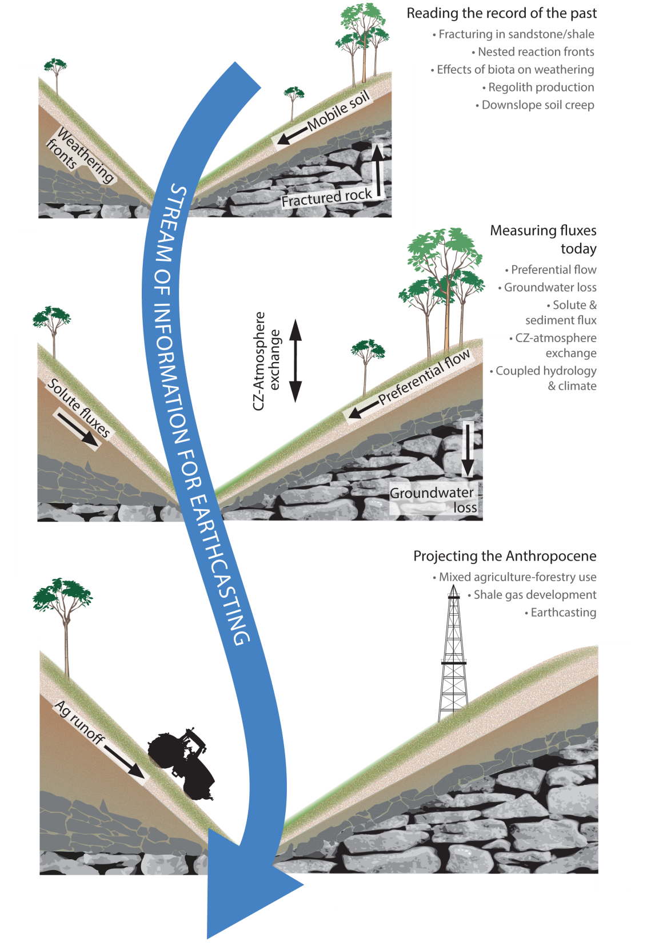
State of the CZO
9/18/15
Our hypothesis: To project CZ evolution into the future requires knowledge of geological history, observations of CZ processes today, and scenarios of human activities tomorrow.

Slide 2
Introduction

Slide 3
Everyone involved
Penn State
Outside Penn State
Sue Brantley, Chris Duffy, Dave Eissenstat, Ken Davis, Jason Kaye, Li Li, Henry Lin, Rudy Slingerland, Tim White, Brian Orland, Joseph Harding, Matt Fantle, Maureen Feineman, Jennifer Williams, Colin Duffy, Andrew Neal, Brandon Forsythe, Dan Arthur, Pamela Sullivan, Yuning Shi, Brian Clarke, Elizabeth Hasenmueller, Chen Bao, Ashlee Dere, Katie Gaines, Isaac Hopkins, Burkely Twiest, Julie Weitzman, Nicole West, Tiffany Yesavage, Xuan Yu, Yu Zhang, Xin Gu, Margot Kaye, Beth Boyer, Liidia Iavorivska, Ryan Jones, Nina Bingham, Annie Klodd, Yuting He, Beth Hoagland, Lillian Hill, Dacheng Xiao, Joanmarie Del Vecchio, Virginia Marcon, Neil Xu, Ismaiel Szink, Warren Reed
Paul Bierman, Al Denn, Friedhelm von Blanckenburg, Yves Goddéris, Jérôme Gaillardet, Douglas Wentzel, Joseph Graney, Frederick Meinzer, Jonathan Nyquist, Laura Toran, Lixin Jin, Lin Ma, Steve Peters, Frank Pazzaglia, Justin Irving, Garth T. Llewellyn, Victor Heilweil, Diana Karwan, Anne Kraipel, Lou Derry, Jed Sparks, Kamini Singha, Eric Kirby, Mike Gooseff, Elizabeth Herndon, Carleton Bern, Kristen Brubaker

Slide 4
NSF Virtual Site Review – November 9th 2015
I. CZO Site Research
Has the CZO made progress in measuring and quantifying the significant processes
of the critical zone?
Has the CZO developed a unifying theoretical framework that integrates new
knowledge of coupled hydrological, geochemical, geomorphic, sedimentary, and
biological processes?
Has the CZO developed and validated systems-level models to predict how the
critical zone responds to external forces?
Has the CZO contributed to the scientific basis for decision-making regarding health,
safety, ecosystem services, and environmental function?
Has the CZO made the site available for use of the other CZOs and the broader
community?
Is the site supporting an interdisciplinary research program using long-term
observations at the CZO that takes advantage of the CZO network effort?
Are the goals of the site aligned with the spatial and temporal scope of CZO research?
Are the various subprojects well integrated and supportive of the site goals?
Has the CZO site complied with the EAR Data Policy and the CZO Data Sharing Policy?
Other relevant comments.

Slide 5
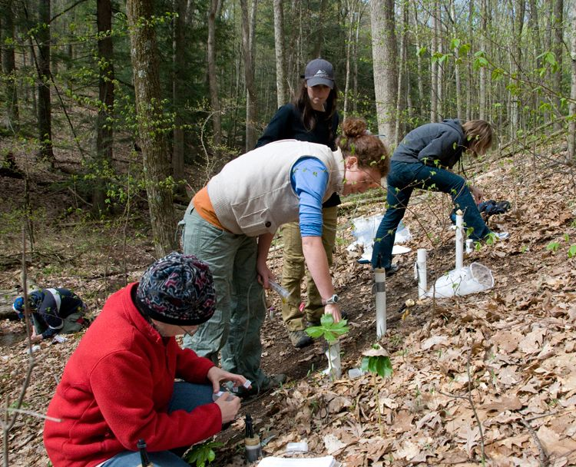
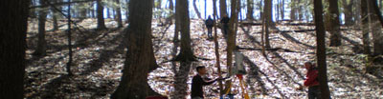
Goals of Shale Hills II
To measure and model the system across timescales from those of the meteorologist to the geologist.
To use our knowledge to project, or “earthcast,” into the future.
To educate 8 grad students, 1 postdoc, and 8 undergrads in state-of-the-art interdisciplinary research

Slide 6
CZO Site Research

Slide 7
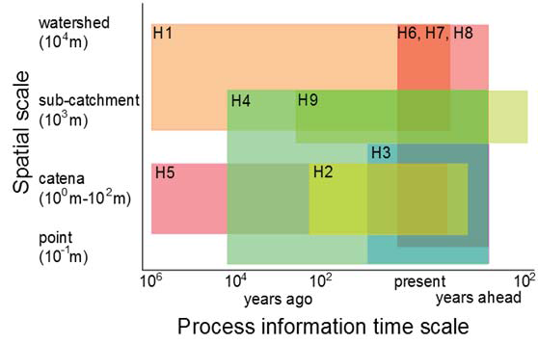
Hypotheses of Shale Hills II
H1 - The fracture hypothesis: Feedbacks among frost shattering, weathering reactions, and the evolution of topography have resulted in an asymmetric distribution of fractures that in turn controls the observed differences in fluid flow in the subsurface between the sun-facing and shaded sides of catchments within Shale Hills and much of the Susquehanna River Basin. Kirby Biermann Singha Brantley
H2 - Imprint of biota on acid- and redox-weathering hypothesis: The distribution of weathering reactions across a landscape can be described as a function of biotic and abiotic production and consumption of acids (CO2, DOC) and O2. Kaye
H3 – The tree-root hypothesis: Trees with deeper roots (oaks) are associated with less frequent tree throw, slower hillslope erosion rates, fewer vertical macropores, faster weathering at depth, and deeper regolith than trees with shallower roots (maples). Eissenstat
H4 – The soil macropore hypothesis: Macropores are important in controlling fluid flow and chemistry in soils derived from various lithologies, but the nature and effects of these macropores differ significantly among shale, calcareous shale, and sandstone. Lin
H5 – The regolith-modeling hypothesis: Greater evapotranspiration on the sunny, north side of Shale Hills means that less water recharges to the stream, explaining why Mg and other cations are less depleted in the regolith on the north compared to the south hillslopes. Li Li
H6 – The stream solute flux hypothesis: Ions that are released quickly from ion exchange sites (Mg, Na, K) throughout the catchment demonstrate chemostatic behavior (~constant concentration in the stream), whereas Fe, Mn, and DOC concentrations vary with changes in watershed-stream connectivity. Sullivan Gooseff Brantley
H7 – The land-air-ecosystem coupling hypothesis: Land-atmosphere fluxes of carbon (C) and water, ground-water hydrology, and ecosystem change are coupled processes at time scales of months to decades. This coupling varies with the lithology and land use and position on the hillslope. Davis
H8 – Water-data integration hypothesis: Co-located, intensive, relocatable measurements of soil moisture, tree sap flux, sapwood area, LAI, ground water depth, temperature, 18O and D/H along with a 4-component radiometer, laser precipitation monitor and landscape-level soil moisture (COSMOS) can be assimilated within a multi-scale distributed modeling framework to project physical processes from Shale Hills to Shavers Creek to YWC and Snake Creek watersheds. Duffy
H9 – Earthcasting hypothesis: Increasing atmospheric CO2 in the future will cause higher temperatures and faster weathering of clays in the catchment, increasing streamwater solute loads. Sullivan Brantley

Slide 8
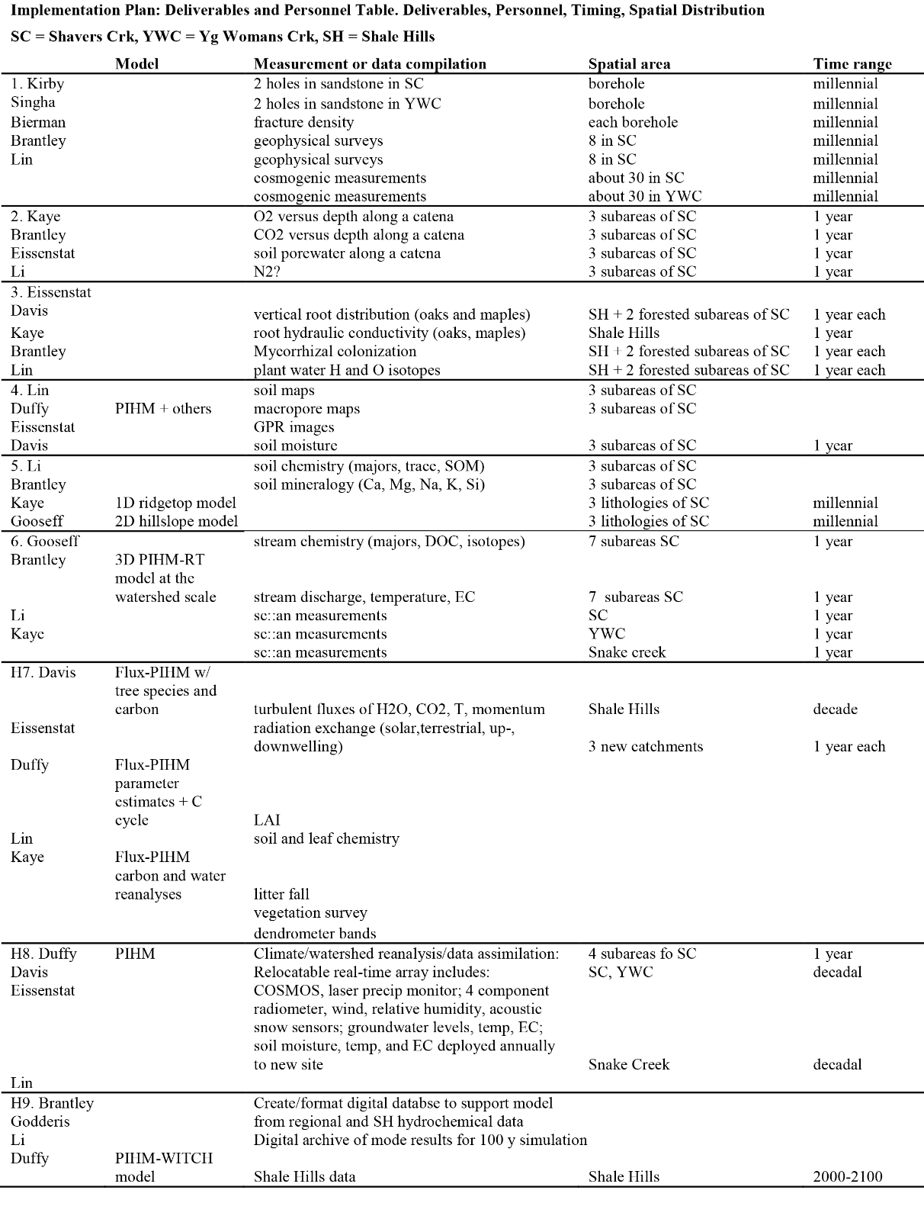

Slide 9
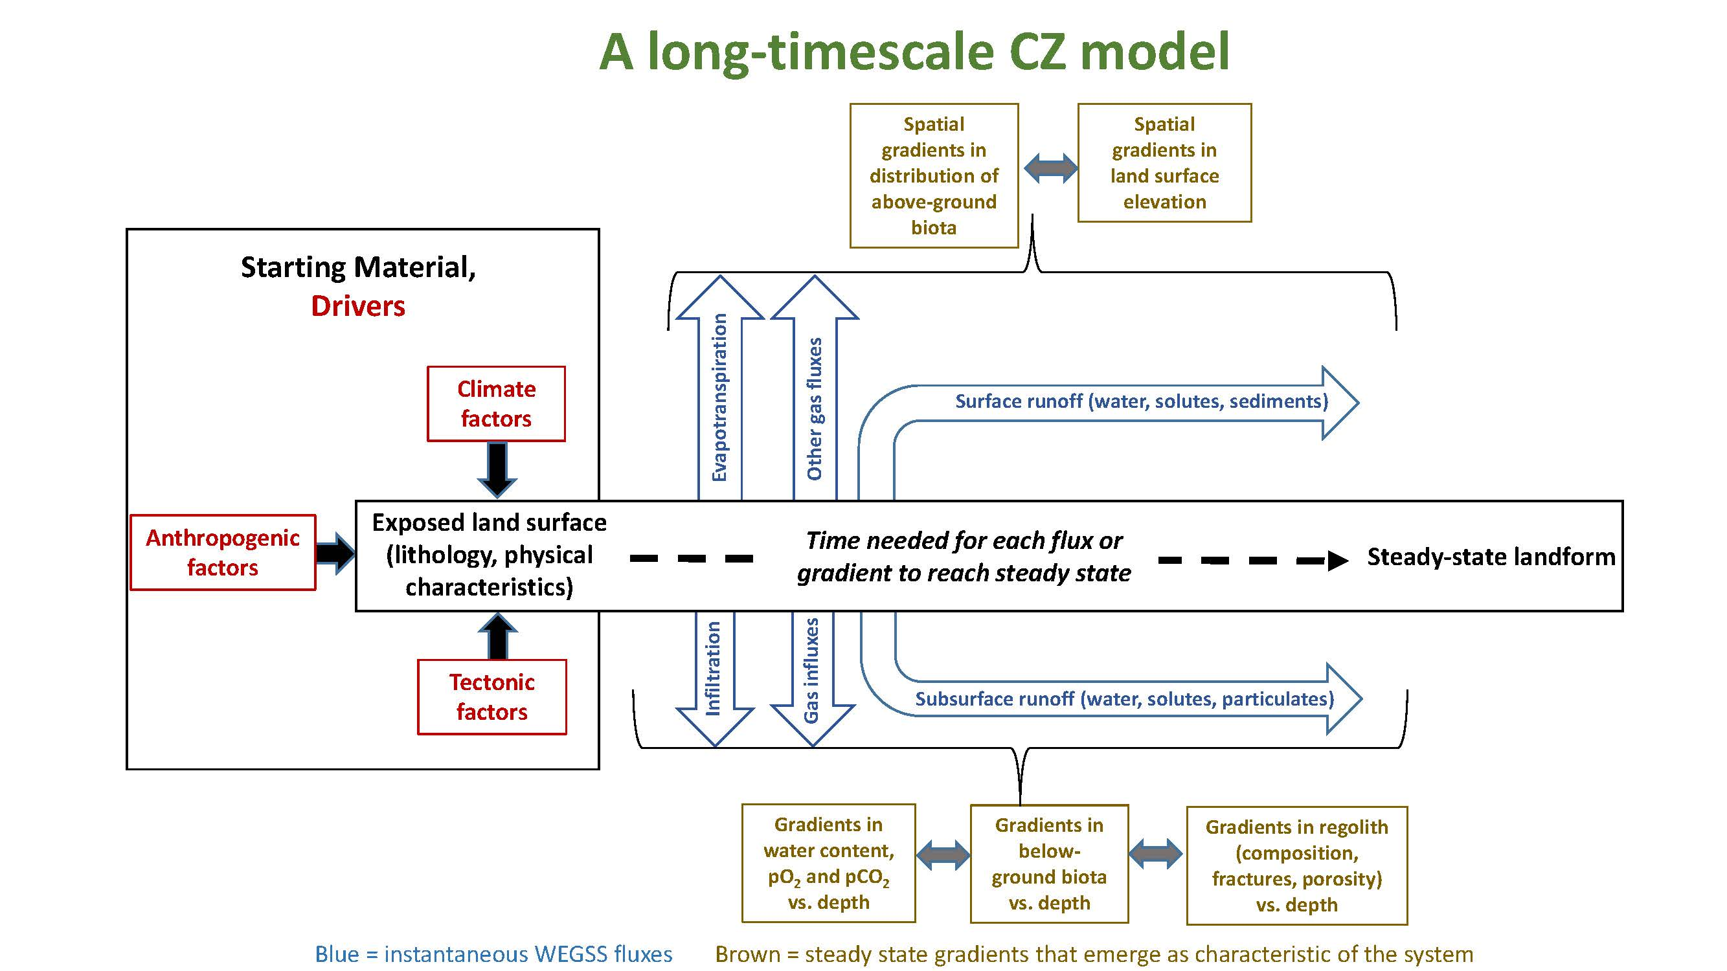
Brantley, S. L., et al.: Designing a suite of measurements to understand the critical zone, Earth Surf. Dynam. Discuss., 3, 1005-1059, doi:10.5194/esurfd-3-1005-2015, 2015.

Slide 10
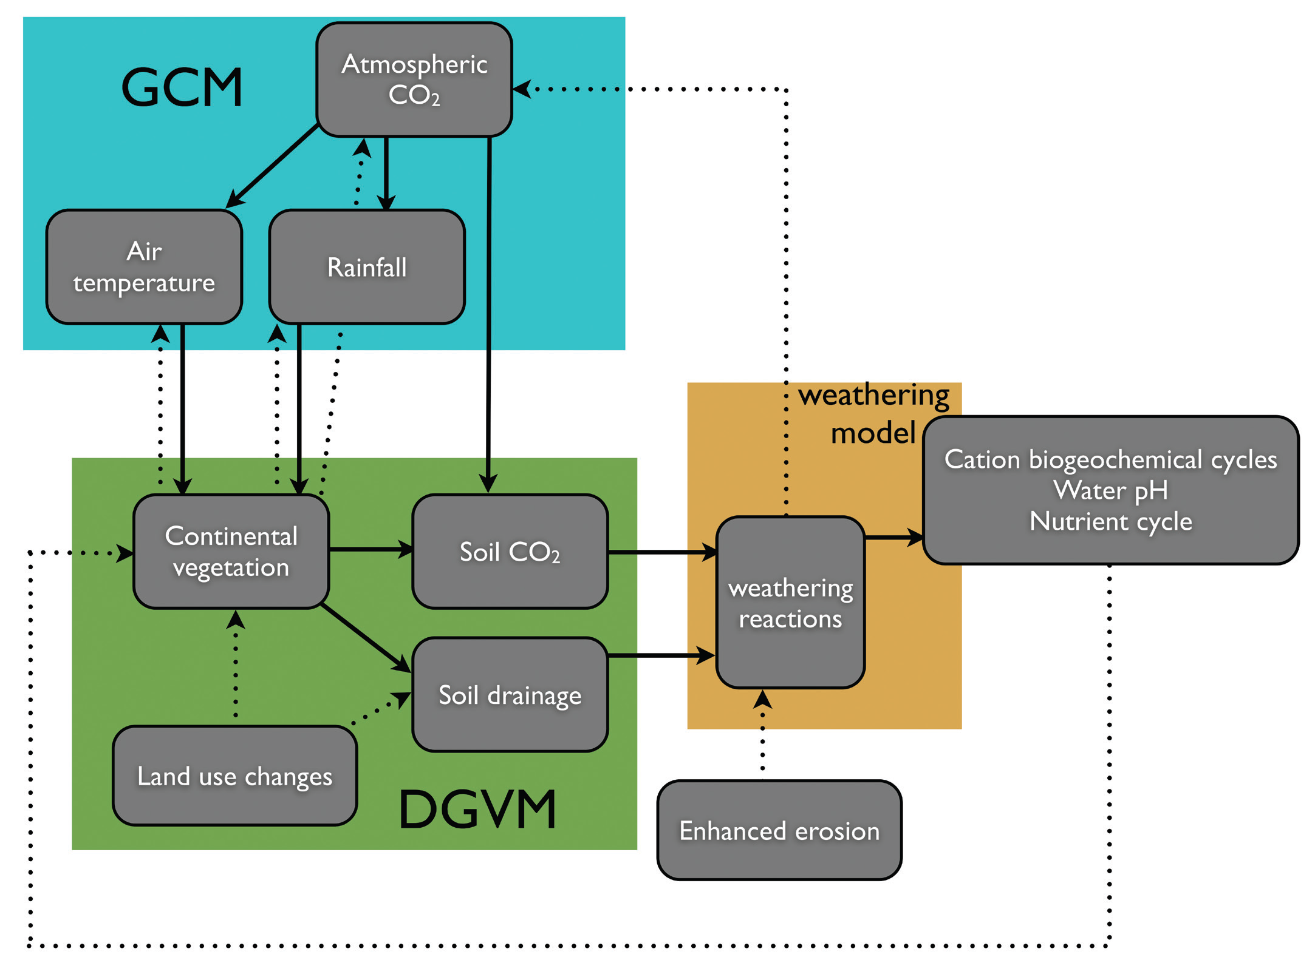
Earthcasting can be achieved by cascading mechanistic climate, vegetation, and process models (here, weathering)
(Goddéris and Brantley 2013)

Slide 11

Christopher Duffy, et al., Designing a Suite of Models to Explore Critical Zone Function, Procedia Earth and Planetary Science, Volume 10, 2014, Pages 7-15, ISSN 1878-5220, http://dx.doi.org/10.1016/j.proeps.2014.08.003. (http://www.sciencedirect.com/science/article/pii/S1878522014000654) Keywords: Critical Zone; weathering; hydrology; ecology; watersheds

Slide 12
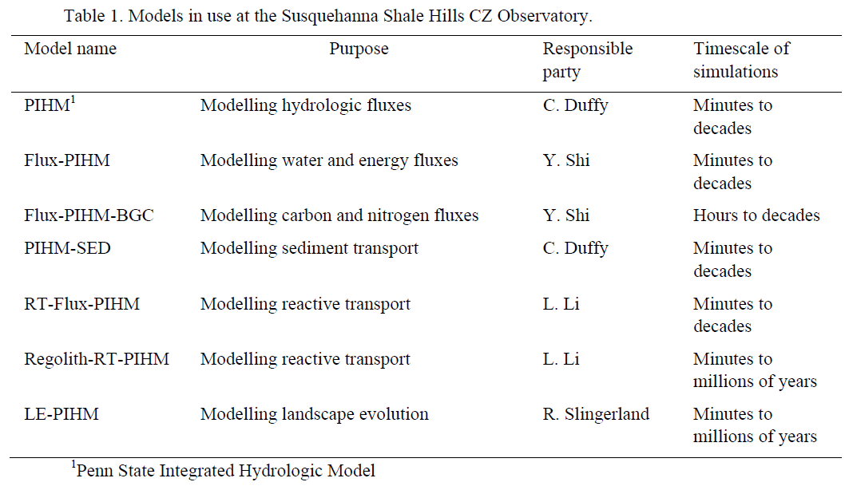
Christopher Duffy, et al., Designing a Suite of Models to Explore Critical Zone Function, Procedia Earth and Planetary Science, Volume 10, 2014, Pages 7-15, ISSN 1878-5220, http://dx.doi.org/10.1016/j.proeps.2014.08.003. (http://www.sciencedirect.com/science/article/pii/S1878522014000654) Keywords: Critical Zone; weathering; hydrology; ecology; watersheds

Slide 13
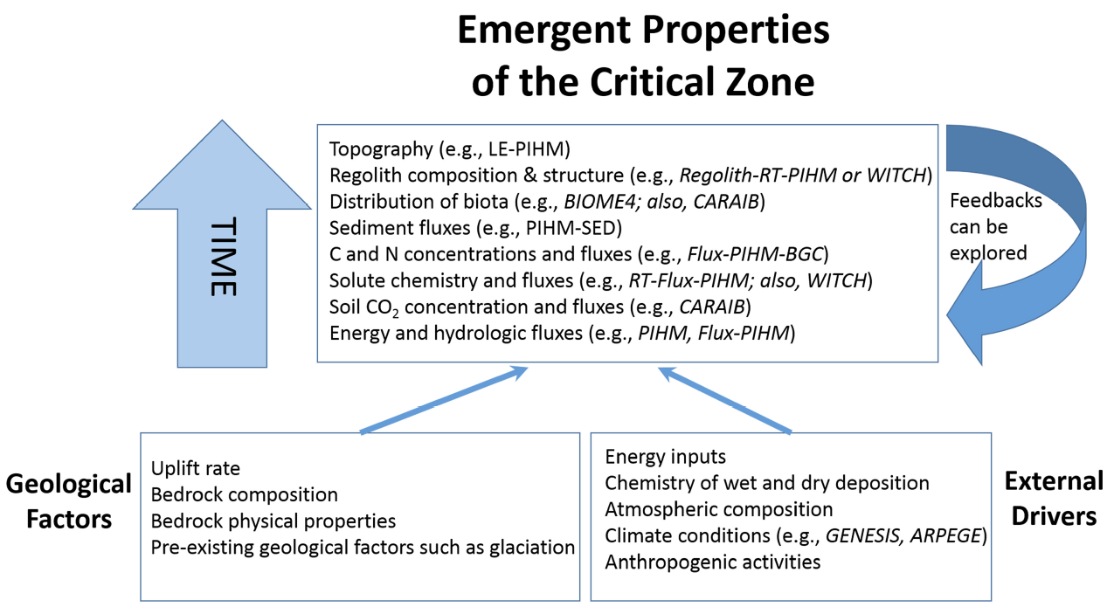
To quantify the evolution of the CZ requires multiple models and datasets to simulate processes at different timescales. The longest timescale models, landscape evolution models (i.e. LE-PIHM), can simulate changing topography, relief, drainage density, and the spatial distribution of regolith for 10⁶ – 10⁷ years. At a slightly shorter timescale, reactive transport models (Regolith-RT-PIHM) can simulate changes in composition and porosity of regolith as it forms on bedrock over timescales up to 10⁶ y; at the same time these models calculate stream and soil porewater chemistry averaged over years. Reactive transport models can also be used for shorter timescales to simulate stream or soil porewater chemistries (RT-Flux-PIHM). None of the PIHM family of models now can be used to calculate the distribution of biota: dynamic vegetation models such as BIOME4 and CARAIB can do this. Likewise, CARAIB can be used to simulate the carbon allocation and plant growth, heterotrophic respiration, and soil carbon content of the subsurface. The distribution of energy and hydrologic fluxes can be simulated with atmosphere – land surface models (Flux-PIHM) or hydrologic models (PIHM) over timescales up to 10² y.
Christopher Duffy, et al., Designing a Suite of Models to Explore Critical Zone Function, Procedia Earth and Planetary Science, Volume 10, 2014, Pages 7-15, ISSN 1878-5220, http://dx.doi.org/10.1016/j.proeps.2014.08.003. (http://www.sciencedirect.com/science/article/pii/S1878522014000654) Keywords: Critical Zone; weathering; hydrology; ecology; watersheds

Slide 14
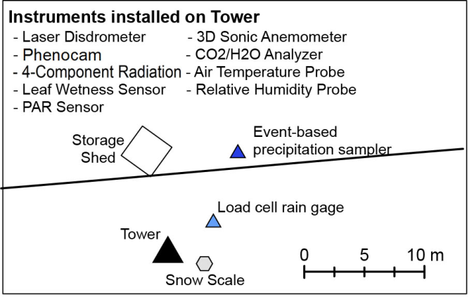
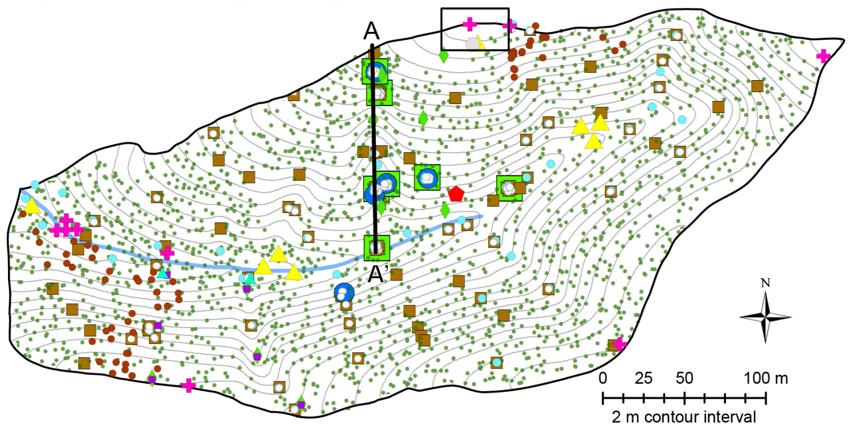
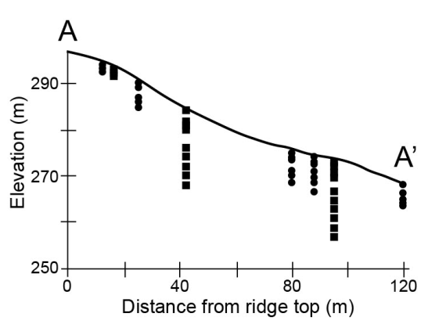
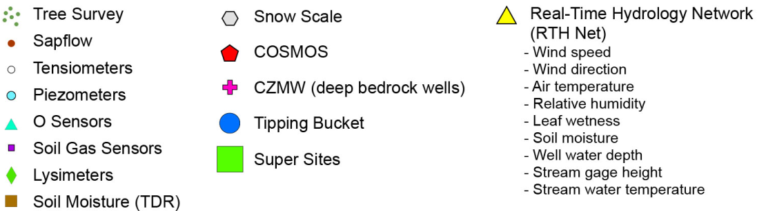
Measure everything everywhere…..in Shale Hills catchment (~ 0.1 km²)
Brantley, S. L., et al.: Designing a suite of measurements to understand the critical zone, Earth Surf. Dynam. Discuss., 3, 1005-1059, doi:10.5194/esurfd-3-1005-2015, 2015.
Mapped summary of the “everything, everywhere” sampling strategy at the Shale Hills subcatchment. Insets show soil moisture sensors (circles) and lysimeters (squares) along the transect shown on the map. Sensor and lysimeter depths are exaggerated five times compared to the land surface elevation. Second inset shows instrumentation deployed at the meteorological station on the northern ridge. Small black dots on the map are the trees that were surveyed and numbered. As we upscale the CZO to all of Shavers creek, many measurements will be eliminated as we emphasize only a Ground HOG and Tower HOG deployment as described for the Garner Run subcatchment.

Slide 15

Going from “measure everything everywhere” to “measure only what is needed”: Paper released for online discussion 17 September – 29 October 2015
http://www.earth-surf-dynam-discuss.net/3/1005/2015/
Please read and contribute to the discussion!

Slide 16
Measure only what we need…..in Shale Hills catchment (~ 0.1 km²)
Map of sensor and sampling infrastructure at Shale Hills that will be maintained under the “measure what we need
plan. Inset shows instrumentation deployed at the meteorological station on the northern ridge. Measurements will be maintained at these sites as part of core CZO data collection.

Slide 17
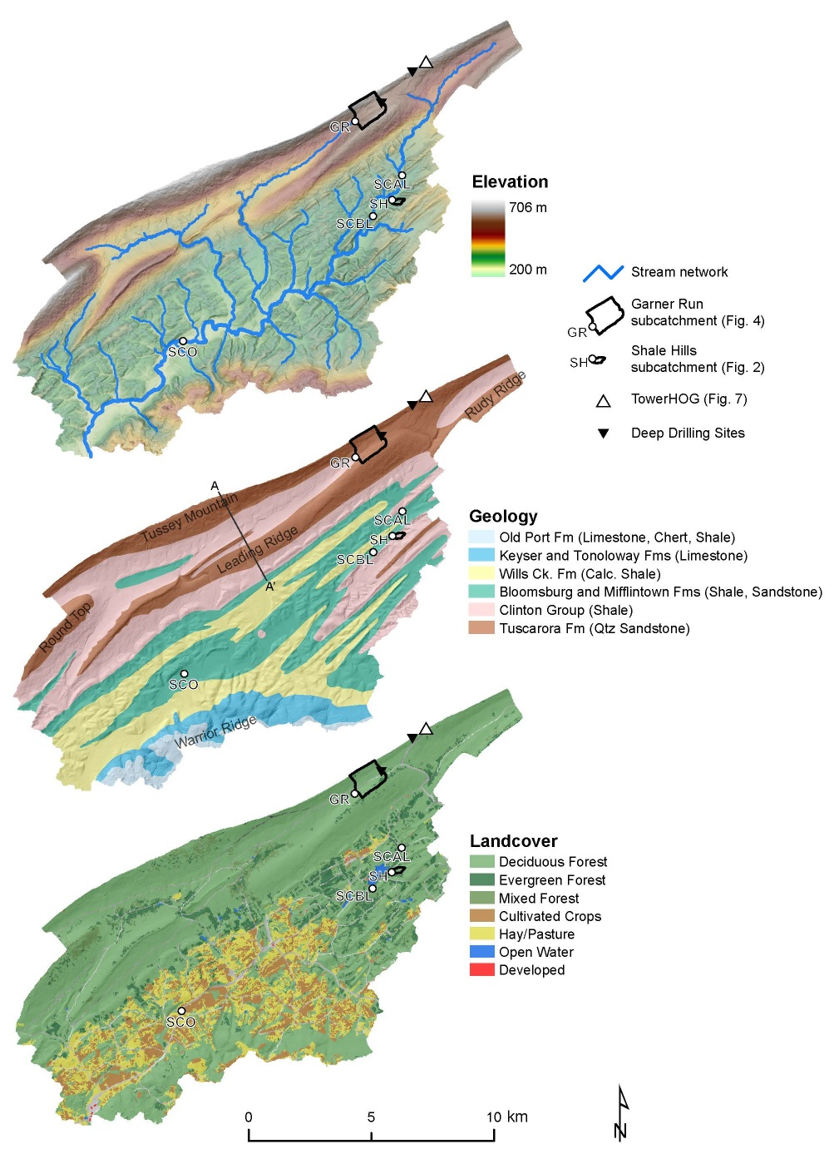
Scaling up …..to Shavers Creek watershed (165 km²)
Will thoroughly investigate two new first-order sub-catchments:
a forested sandstone site (along Garner Run, marked GR)
an agricultural calcareous shale site (green square).
Three sites on Shavers creek are also being monitored for discharge and periodic streamwater chemistry (marked SCAL, SCBL, SCO).
Brantley, S. L., et al.: Designing a suite of measurements to understand the critical zone, Earth Surf. Dynam. Discuss., 3, 1005-1059, doi:10.5194/esurfd-3-1005-2015, 2015.

Slide 18
Top Left:
On the south side of the catchment, three soil pits were emplaced along a catena (red dots): Leading Ridge Foot Slope (LRFS), Leading Ridge Mid Slope (LRMS), Leading Ridge Ridge Top (LRRT).
On the northern (Tussey mountain) side of the catchment, only one soil pit was emplaced, Tussey Mountain Mid Slope (TMMS).
Vegetation surveys were completed at every black dot for transects that cross each soil pit location.
Bottom Left: Planned sensors (diamonds) in the soil pits along the catena at Garner Run.
This sampling paradigm represents our implicit hypothesis of how we can use landscape to choose a stratified sampling strategy for the CZ.
The soil catena and vegetation sampling paradigm

Slide 19
Ground HOG
Measurement | Manufacturer | Model | Collection freq. | Number | Depths (cm)
Soil Moisture | Stevens Water Monitoring | Hydra | 10 min | 3 | 10, 20, 40
[O2] | Apogee | SO | 30 min | 2 | 20, 40
[CO2] | Forerunner Research | GP | 30 min | 2 | 20, 40
Soil Moisture | Eissenstat lab | TDR waveguides | Monthly? | 12 | 10, 20, 40, D-10
Sapflow | Eissenstat lab | n/a | 30 min | 4? 5? | n/a
The Ground HOG sensor array represents a focused approach to soil moisture,
soil gas and sapflow measurements. Ground HOGs will be deployed at 4 locations
in Garner Run and at Shale Hills.

Slide 20

Ground HOG: sensors deployed at catena + TMMS
Datalogger
Sapflow (x4?)
10 cm
Hydra, TDR
20 cm
Hydra, TDR, [O₂], [CO₂]
40 cm
Hydra, TDR, [O₂], [CO₂]
D-10 cm
TDR

Slide 21
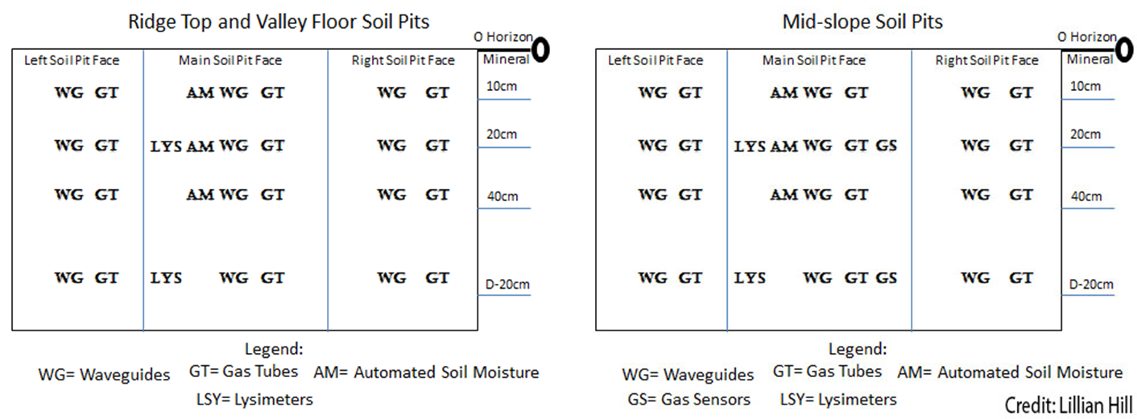
Ground HOG: sensors deployed at catena + TMMS
Schematic summary of all the sensors deployed as Ground HOG, including where the sensors are deployed. D-20cm refers to a position 20 cm above the bottom of the pit.
Brantley, S. L., et al.: Designing a suite of measurements to understand the critical zone, Earth Surf. Dynam. Discuss., 3, 1005-1059, doi:10.5194/esurfd-3-1005-2015, 2015.

Slide 22
Tower HOG
Measurement | Manufacturer | Model | Collection freq.
[CO2] | Li-cor | LI-7500A | 10Hz
[H2O] | Li-cor | LI-7500A | 10Hz
Wind velocity | Campbell Scientific | CSAT3 | 10Hz
Precipitation | Thies Clima | LPM | 30 min
Precip type | Thies Clima | LPM | 30 min
Tair | Vaisala | HMP60 | 30 min
Rel Humidity | Vaisala | HMP60 | 30 min
LW Radiation* | Kipp & Zonen | CGR3 | 30 min
SW Radiation* | Kipp & Zonen | CMP3 | 30 min
Snow depth† | Campbell Scientific | SR50A | 30 min
Digital Imagery | Campbell Scientific | CC5MPX | 24 hr
Soil moisture† | Hydroinnova | CRS-2000 (COSMOS) | 30 min
Tower HOG system is a minimal set of sensors to support eddy covariance and micro-
meteorological studies. Instrumentation is consistent with sensors currently at Shale Hills.
*--upwelling radiation at tower (paired with downwelling at Shale Hills)
†--designed as part of tower system but will be deployed at a Ground HOG location

Slide 23
Tower HOG
Garner Run Tower Status:
May use existing tower at Jo Hays Vista, currently used by WPSU microwave relay
Brandon is waiting for response from Crown Castle regarding submitted application
30 m
3D wind, [CO₂], [H₂O], Tair,
RH, radiometers, camera
2 m
LPM
1 m
Datalogger
Power supply
(Crown Castle)

Slide 24
WOG: Paradigm for measuring stream flow and chemistry in each sub-catchment and Shavers Creek watershed
Measuring water and energy fluxes: Tower HOG. Tower HOG refers to deployment of water and energy sensors. Tower HOG will be used in each of the three subcatchments. Tower HOG will include:
Measurement of latent and sensible heat fluxes via eddy covariance
Measurement of radiative energy fluxes using a four component (upwelling, downwelling, terrestrial, and solar) radiometer
A laser disdrometer (LPM Theis Clima GmbH)
Proposed locations for the tower installation and proposed shallow and deep drilling in the Garner run sub-catchment (yellow outlined rectangular region).

Slide 25
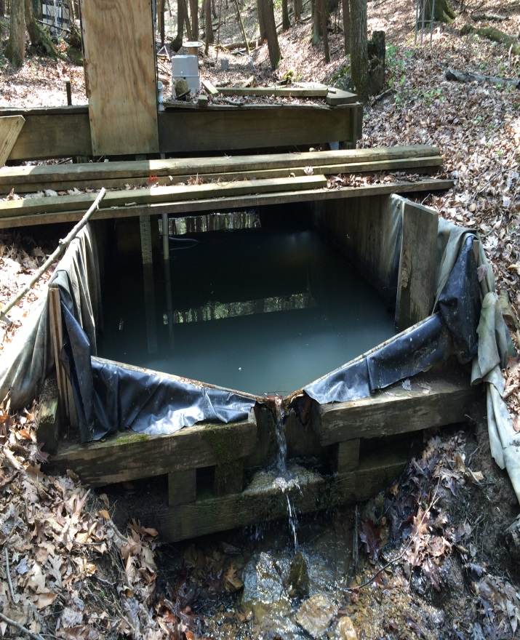
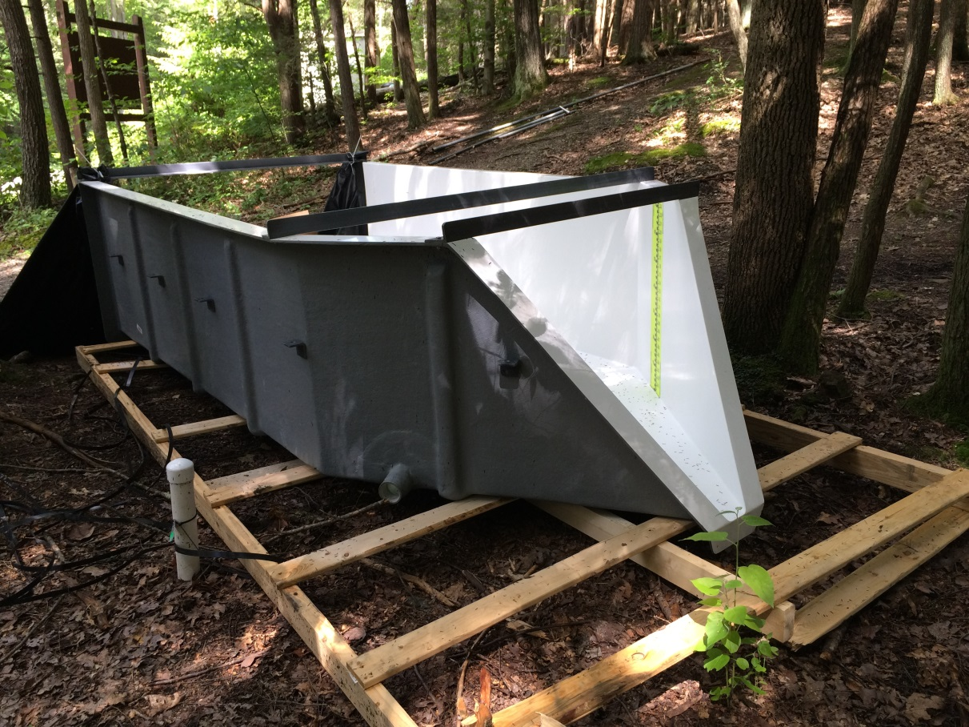
Shale Hills Weir
Existing weir (left) to be replaced with new flume (right).
Flume has been delivered to site.
Install timeline TBD.
New fiber data connection to SH (being installed now) will facilitate live discharge data

Slide 26
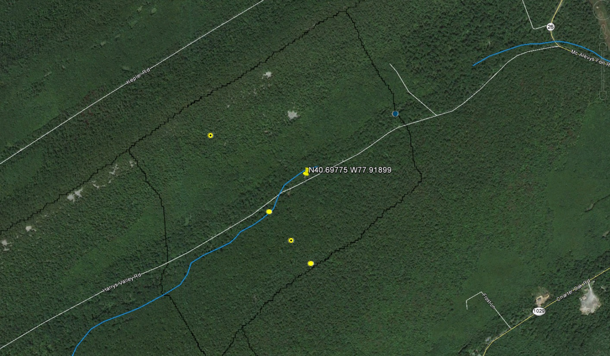
Harrys Valley Well 1
Blue curves: Streams
Black lines: GR boundary
Yellow circles: GR transect soil pits
Pin: HV Well 1
Collaborators from the University of Guelph and Stone Environmental, Inc. teamed with Brandon to complete a well in the Garner Run sandstone catena.
Provides sampling zones at 30, 20, and 7 feet below the ground surface in the Tuscarora Formation.
Drilled: 8/26-8/27/15
Elevation: 1737 ft.

Slide 27
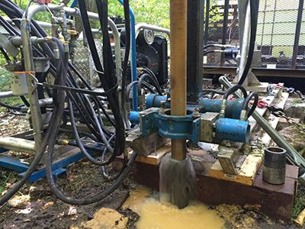
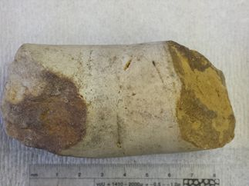
Harrys Valley Well 1
Recovered material from 11' - 16' zone
Hydracore Prospector
Additional Details, including core photos:
https://criticalzone.org/images/national/associated-files/Shale%20Hills/HV_well_1_CZO_report.pdf

Slide 29
SSHCZO Measurement Suite
1/3
Measurement | SH | GR | SCAL | SCBL | SCO | AG
3-D Wind Velocity | KD | KD
4-Component Radiation (upwelling & downwelling; SW & LW) | KD | KD
Air Temperature | KD | KD
Chemistry (DOC, TOC, DO, NO3, NH4, K, F, Cl, pH, EC, ORP) |  | TR | TR | TR | TR
Chemistry (major cations, Fe, Mn, Al, Si) | SB
CO2 Concentration | KD | KD
Dendrometer-Basal Growth | MK | MK
Digital Imagery / PhenoCam | * | DE
Discharge | TR | TR | TR | TR | TR
Groundwater Level | HL | HL
Groundwater temperature
H2O Concentration | KD | KD
Hyporheic zone exchange (streambed water temperature) | TR
In situ 10Be concentrations in surface boulders (planned) |  | PB
Note – This is a work in progress. Please inform Dan of any changes/corrections ASAP.
SH - Shale Hills
GR - Garner Run
SCAL - Shavers Creek - Above Lake
SCBL - Shavers Creek - Below Lake
SCO - Shavers Creek Outlet
AG - Agricultural Site
KD - Ken Davis TR - Tess Russo
SB - Sue Brantley MK - Margot Kaye
DE - Dave Eissenstat PB - Paul Bierman
JK - Jason Kaye HL - Henry Lin
LL - Li Li * - External
Blue – Active Data Being Collected

Slide 30
SSHCZO Measurement Suite
2/3
Measurement | SH | GR | SCAL | SCBL | SCO | AG
Leaf Area Index | DE
Leaf Litter | MK | MK
Meteoric 10Be concentrations in hillslope regolith (existing) | PB
Precipitation Amount
Precipitation Type
Relative Humidity | KD | KD
Sap Flux | DE | DE
Snow Depth
Soil CO2 | JK | JK
Soil Dielectric | HL | HL
Soil Moisture - Stevens | HL | HL
Soil Moisture - TDR | HL | DE
Soil Moisture - COSMOS | * | LL
Soil O2 | JK | JK
Note – This is a work in progress. Please inform Dan of any changes/corrections ASAP.
SH - Shale Hills
GR - Garner Run
SCAL - Shavers Creek - Above Lake
SCBL - Shavers Creek - Below Lake
SCO - Shavers Creek Outlet
AG - Agricultural Site
KD - Ken Davis TR - Tess Russo
SB - Sue Brantley MK - Margot Kaye
DE - Dave Eissenstat PB - Paul Bierman
JK - Jason Kaye HL - Henry Lin
LL - Li Li * - External
Blue – Active Data Being Collected

Slide 31
SSHCZO Measurement Suite
3/3
Measurement | SH | GR | SCAL | SCBL | SCO | AG
Soil Temperature | HL | HL
Stage/Level | TR | TR | TR | TR | TR
Suspended sediment chemistry (major cations, Fe, Mn, Al, Si) | TR
Tree Survey (Height, Diameter, Species Distribution) | MK | MK
Turbidity | TR
Virtual Temperature | KD | KD
Water chemistry (DOC, TOC, DO, NO3, NH4, K, F, Cl, pH, EC, ORP, major cations, Fe, Mn, Al, Si) | TR | TR
Note – This is a work in progress. Please inform Dan of any changes/corrections ASAP.
SH - Shale Hills
GR - Garner Run
SCAL - Shavers Creek - Above Lake
SCBL - Shavers Creek - Below Lake
SCO - Shavers Creek Outlet
AG - Agricultural Site
KD - Ken Davis TR - Tess Russo
SB - Sue Brantley MK - Margot Kaye
DE - Dave Eissenstat PB - Paul Bierman
JK - Jason Kaye HL - Henry Lin
LL - Li Li * - External
Blue – Active Data Being Collected

Slide 32
NSF Virtual Site Review – November 9th 2015
II. Education and Outreach
Has the CZO pursued effective education and development of a diverse cohort of students engaged in
critical-zone research and related issues?
Has the CZO been actively engaged in outreach beyond the traditional academic and scientific communities?
Has the CZO identified goals, strategies, plans, and metrics for its public outreach and education activities,
including broadening participation of underrepresented groups?

Slide 33
Cross CZO Activities we Proposed
Drill the Ridge – drill ridge, analyze geochemically, hydrologically, geophysically – Harry’s Valley Well drilled. We do not have the money to drill Tussey Ridge but we have discovered a well that was drilled in the 1970s there and are attempting to get data for it.
Workshop - Shale Hills ran 2.5-day CZNR Workshop on a cross disciplinary topic, “Probing the Critical Zone – Four Tree Puzzles”, led by tree physiologist and ecologist D. Eissenstat. Workshop will included 30 scientists/students from in/outside the CZO network (September 9 - 11, 2015).
Field campaign – will lead a campaign to conduct a spatially intensive synoptic sampling of stream solute and heat fluxes (measuring stream chemistry, temperature, and discharge) in the larger Shavers Creek watershed (Year 3). We cancelled this effort and used money for drilling.
CZ-Tope: An international initiative to promote the use of multiple isotopes in CZ sites (Sullivan and Grit Steinhofel are spearheading). Oral and poster sessions at Goldschmidt 2015, Special Issue in Chemical Geology, and a manuscript is in preparation.
Cyber-seminars - The CZOs will work with R. Hooper, Director of CUAHSI, to run six cyber-seminars/yr. Nothing has happened on this front.
Cross-CZO modeling – Through a series of cross site visits to other CZOs, modelers will be cross-fertilized in terms of conceptualizations and codes and will learn how to make best use of available data. (Travel money available for this). Our effort here has been focused on the Q-C workshop and the Tree Workshop and CSDMS (Li Li and Chris Duffy usually attend)
S::can sensors have been emplaced

Slide 34
Seminar Schedule 2014-2015
September 19th: Susan Brantley, Distinguished Professor of Geosciences and CZO PI, - “The State of the CZO”
October 17th: Hyojin Kim, Postdoctoral Scholar with EESI, - “Water chemistry evolution through the critical zone revealed by parallel hydrochemistry observations”
November 7th: Chen Bao, PhD Candidate Petroleum and Natural Gas Engineering, -“Development of an integrated hydrogeochemical model RT-Flux-PIHM: what have we learned?”
November 14th: Fabio Reis, Visiting Scholar, “Stochastic models and dissolution processes”
December 5th: Margot Kaye, Assistant Professor of Forest Ecology, will present “Forests and the Critical Zone” in 117 EES Building.
January 16th: Precepts for Collaboration discussion
February 13th: Yu Zhang, PhD Candidate Environmental Engineering, “A Next Generation Landscape Evolution Model with Applications to the Shale Hills CZO”
March 20th: Garner Run Updates
April 10th: Trees in the CZO
May 11th– 12th: SSHO All-Hands

Slide 35
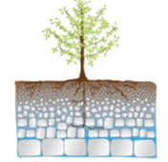
Tree Workshop (Sept 9-11th, 2015)
Exploring Four Critical Puzzles about Trees, Water, and Soil: A Vision for Research
29 total participants from across US and Canada, 6 are students
3 international
15 institutions
12 oral presentations
1 field trip to the CZO
4 thought provoking posters
Proposed paper: Building and plumbing the CZO
Nov 15: template draft: we show to an editor
Jan 15: 1st draft we can show to friends

Slide 36
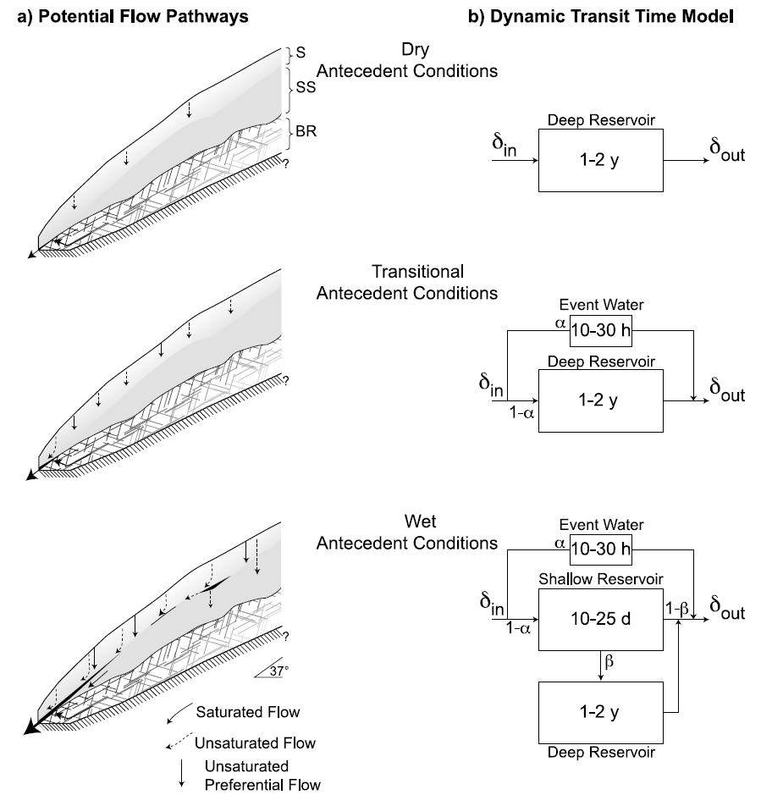
Graham and McDonnell, 2010
A diagram of a conceptual model illustrating (a) the variable flow pathways and (b) transit times contributing to runoff through three wetness phases.
The hillslope is represented by a soil layer (S), a subsoil layer (SS) (weathered bedrock), and bedrock (BR) and shows hypothesized flow pathways during three different antecedent wetness stages (dry, transitional, and wet).
Residence time components change under different wetness conditions and are illustrated by the conceptual reservoirs denoted with mean transit times; δ_{in} and δ_{out} designate tracer input and output signals, and the parameters α and β indicate the proportions of event water and deep subsurface water, respectively.
Note that the illustrations are not drawn to scale.
McGuire, K. J., and J. J. McDonnell (2010), Hydrological connectivity of hillslopes and streams: Characteristic time
scales and nonlinearities, Water Resour. Res., 46, W10543, doi:10.1029/2010WR009341.

Slide 37
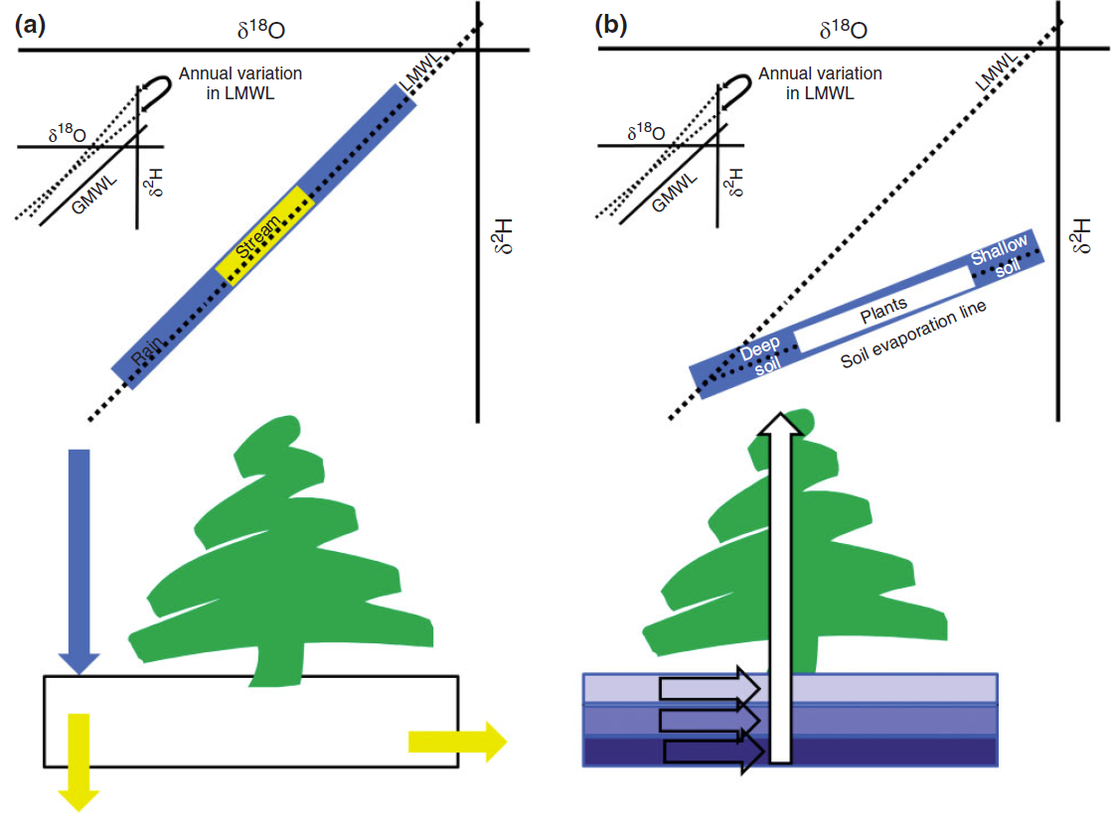
WIREs Water 2014, 1:323–329. doi: 10.1002/wat2.1027
The two water worlds hypothesis in diagrammatic form, showing (a) the mobile water mixing space and schematic representation of mixing and (b) the low mobility water mixing space and schematic representation of mixing. Streamwater is lagged and damped relative to the rainfall input signal and therefore represents a narrower distribution of isotope values. Similarly, the plant water values represent a narrower range than the tightly bound soil water, representative of the depth where water is extracted through the soil profile. Shallower soil waters plot farthest away from the meteoric water line (due to evaporation); deepest soil waters plot on the meteoric water line.

Slide 38

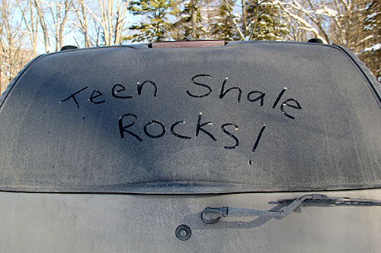
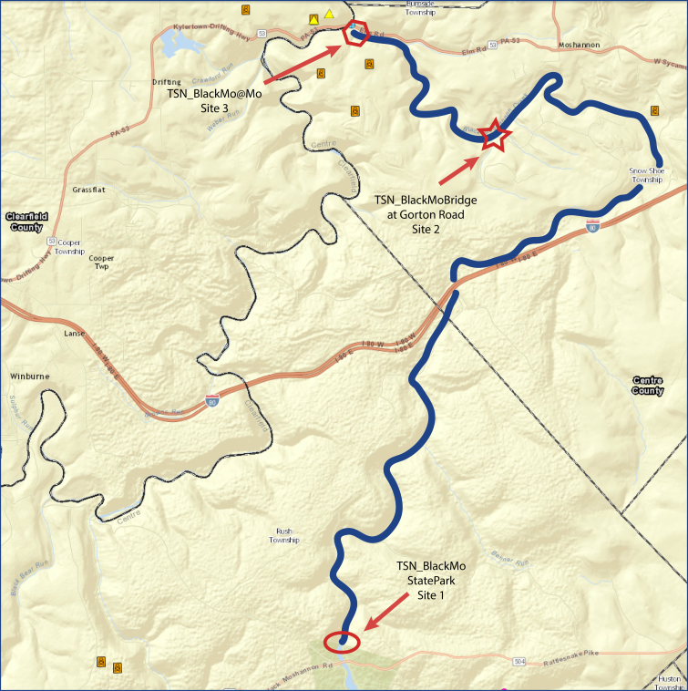

OUTREACH - TeenShale Network – State College Area High School Earth Science
2015-2016 is 4th academic year, 2 field trips per month
Water quality monitoring at Black Moshannon State Park and downstream
Graduate Student Opportunities!!!
COMING SOON!

Slide 39
Seed Grant Proposals in Support of Critical Zone
Science in the Susquehanna Shale Hills CZO II
Dr. Kristen Brubaker, Hobart and William Smith Colleges, Modeling fine-scale above ground carbon storage using LiDAR: A comparison across two watersheds
Original plan for future: funding 1-2 awards/y up to 20k total funds available. We expect grants will be used for activities that further Critical Zone science in the observatory. Activities might include: i) funding for researchers to conduct new measurements in the SSHO, ii) funding to deploy novel sensors or instrumentation, or iii) funding for PSU students (i.e students on site) or non-PSU students to work at SSHO.
Should we do more seed grants?

Slide 40
Previously Awarded Seed Grant Proposals in Support of Critical Zone Science in the Susquehanna Shale Hills CZO II
2013-2014
Dr. Lixin Jin, UTEP, Using carbon isotopes to determine the sources and mass balance
of CO₂ during shale weathering at Susquehanna Shale Hills Critical Zone Observatory
Dr. Jonathan Nyquist, Temple University, Geophysical Prediction of Water Migration
along the Soil-Bedrock Interface at the Shale Hills Critical Zone Observatory
Dr. Margot Kaye, PSU, Filling gaps in the aboveground carbon budget of the SSHO CZO
Dr. Lin Ma, UTEP, Quantifying regolith formation rates with U-series isotopes along the
shale weathering transect within the Susquehanna Shale Hills Critical Zone Observatory
2014-2015
Dr. Elizabeth Herndon, Kent State, Investigating inorganic and organic-mediated cation
transport from soils to streams
Dr. Carleton Bern, USGS, Quantification of mass balance of colloidal material across
lithologies and environments

Slide 41
NSF Virtual Site Review – November 9th 2015
Project Management
Has the CZO Site Director implemented an efficient and effective governing structure to support all CZO
project activities as specified in the Cooperative Agreement with NSF?
Have critical elements of the governance structure met regularly and documented outcomes of their
discussions?
Does the CZO Management Plan identify sufficient milestones and metrics to monitor progress and to
determine the level of continuing support? Have these milestones been met and the metrics measured? Are plans .
for remedial actions in place where project milestones have not been adequately met as articulated in Annual
and Interim Reports?
Does the Management Plan clearly identify roles and responsibilities for the lead and partner
institutions/organizations that are part of the CZO? Have these roles and responsibilities been
executed?
Does the CZO Management Plan identify goals, strategies, and metrics for engaging other CZOs and the
broader community in research activities? Have these goals been executed?
Does the CZO Management Plan provide guidance that enables the CZO to respond to opportunities
provided by scientific breakthroughs and unexpected events?

Slide 42
SSHCZO Organization
Graduate & Undergraduate Students
Technical & Program Management
Executive Committee
Jennifer Williams
Program Coordinator
Sample-based Data Specialist
David Eissenstat
Brandon Forsythe
Watershed & Sensor-based
Data Specialist
Ken
Davis
Postdocs
Yuning Shi
(Rotating)
Dan Arthur
Data Manager / Cyberspecialist
SSHO Faculty
Lillian Hill
(Student)
Advisory Board
Kip Solomon
Scott MacKay
Dorothy Merritts
Susan Brantley
Director, PI
SSHCZO
National CZO Network Implementation Group
National CZO Network Steering Committee
Science
Management/Administration
National Office
Notes:
Brilliant!

Slide 43
CZO Executive Committee
Meets monthly during academic year
  3 permanent PIs, 1 rotating PI (academic year), and 1 student member
  Previous rotating PI: Henry Lin (year 1) and Li Li (year 2)
  Previous student: Nicole West (year 2)
  Project Coordinator: shares minutes with team

Slide 44
CZO Advisory Committee and our Annual All Hands Meeting
Kip Solomon, groundwater hydrogeochemist, Univ of Utah, visited us for 2013 All Hands meeting (5/8/13-5/10/13)
Scott Mackay, tree dynamics specialist, Univ of Buffalo, visited us for 2014 All Hands meeting (5/18/14-5/20/14)
Dorothy Merritts, geomorphologist, Franklin and Marshall College, visited us for 2015 All Hands meeting (5/10/15-5/12/15)

Slide 45

Program Coordinator and Sample-based Data Specialist - Jennifer Williams (jzw126@psu.edu)
Facilitate communications between and among hypothesis teams,
CZO science and outreach opportunities
Coordinate research with Penn State and Rothrock State Foresters
Compile annual reports; facilitate seed grant program; facilitate
travel; organize All Hands and CZ workshops, seminar series,
executive committee and various other meetings; order supplies
Manage national and local website presence
Coordinate fieldtrips and field campaigns for PSU and non-PSU
research activities
Communicates regularly with CZO-NO and NSF
Maintains institutional knowledge of PSU and
CZO procedures
Team Lead for TeenShale Network Outreach
Compiles and organizes (with students) CZO samples for registration
with SESAR (IGSNs – www.geosamples.org) and EarthChem Library
(doi’s – www.earthchem.org)
Working towards long-term archival of CZO samples (sub-samples of
soils, leaf litter, soil porewaters, groundwater, and precipitation) in
central location – will need to have destroy dates on all samples
Collaborative development of CZchemDB: will teach functionality of
use, provide guidance in population, and maintain discovery and
access of geochemical data

Slide 46
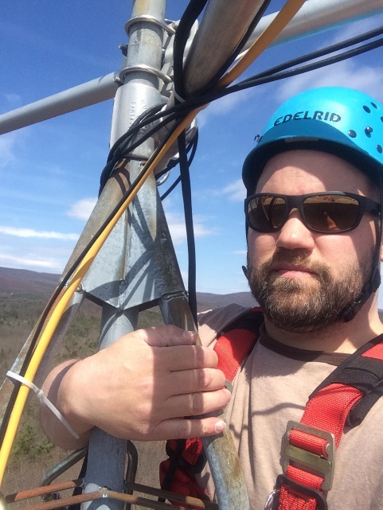
Watershed Specialist - Brandon Forsythe
brf11@psu.edu
(814)865-0294
-----------------------------------------------------------------------------------------
Maintain sensor infrastructure at Shale Hills and Garner Run
Coordinate deployment of sensors at other sites in SSHCZO
Manage long-term field sites supporting research efforts internally and externally
Coordinate sensor data collection, processing and archiving (with Cyberspecialist)
Assist with Teen Shale Network
(discharge measurements, sensor deployment,
sampling)

Slide 47

Cyberspecialist - Dan Arthur (dka12@psu.edu)
SSHCZO Data Management Responsibilities:
Data/File Management (Collection – Coordinated with Watershed Specialist & Field Team, Formatting, Conversion)
Architecture (Database Design & Content Management)
Retention (Backup/Archive Strategy, Coordinated w/ ITS)
User Access, Internal (SSHCZO) & External
Website Content Assistance/Maintenance
GIS Support
Visualization/Plots Assistance
Seminar/Workshop AV Management

Slide 48
Graduate Students Supported
Fall 2013: None (grant was received in Oct '13).
Spring 2014: Zhang Yu, Yuting He, Isaac Hopkins
Summer 2014: Katie Gaines, Nell Hoagland, Yuting He, Julie Weitzman, Zhang Yu
Fall 2014: Chen Bao, Dacheng Xiao, Zhang Yu, Yuting He, Katie Gaines, Al Denn (University of Vermont)
Spring 2015: Katie Gaines, Chen Bao, Dacheng Xiao, Yuting He, Yu Zhang, Al Denn (University of Vermont)
Summer 2015: Yu Zhang, Chen Bao, Dacheng Xiao, Joanmarie Del Vecchio, Yuting He, Katie Gaines
Fall 2015: Joanmarie Del Vecchio, Lillian Hill, Dacheng Xiao, Chen Bao, Xu Hua

Slide 49
REU/RETs and the CZO
2014: 2 RETs and 6 REUs, each presented poster at CUAHSI’s Biennel Meeting in Shephardstown, WV, July 28th – 30th
  Olivia Beaulieu (REU, University of Massachusetts Amherst
  Jessica Fisher (REU, Brown University)
  Quincey Johnson (REU, Hobart and William Smith Colleges)
  Christine Kim (REU, Temple University)
  Paul Longwell (RET, Hollidaysburg Area High School)
  Kim Schmid (REU, The Pennsylvania State University)
  Mieke Vrjimoet (REU, Bennington College)
  Mark Yeckley (RET, Glendale School District)
2015: 2 RETs and 6 REUs, 100% female, 3 posters presented at ESA in Baltimore, MD, August 10th
  Kelsey Bicknell (REU, University of New Mexico)
  Siobhan Donnelly (RET, Centre Learning Community Charter School, State College, Pa.)
  Sharon Dykhoff (RET, Dominion Christian School, Oakton, VA)
  Sarah Granke (REU, Pomona College, Claremont, CA)
  Meaghan Redmon (REU, Hanover College, Hanover, IN)
  Maggie Ruppel (REU, Wittenberg University, Springfield, OH)
  Anna Schwyter (REU, Pennsylvania State University)
  Meaghan Shaw (REU, Southern Methodist University, University Park, TX)

Slide 50
CZO Four Seasons
Matthew Kenney (2015): Isotopic data sonification: Shale Hills Critical Zone Observatory. Master of Fine Arts, Arts and Architecture, The Pennsylvania State University.
  2015 SSHCZO All-Hands “Data visualization and sonification”
  Extended abstract was presented at the International Conference on Auditory Display (ICAD) 2014 at New York University.

Slide 51
Hypothesis Team Updates

Slide 52
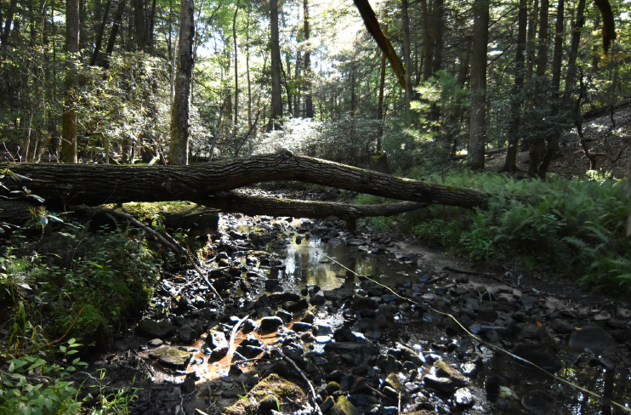
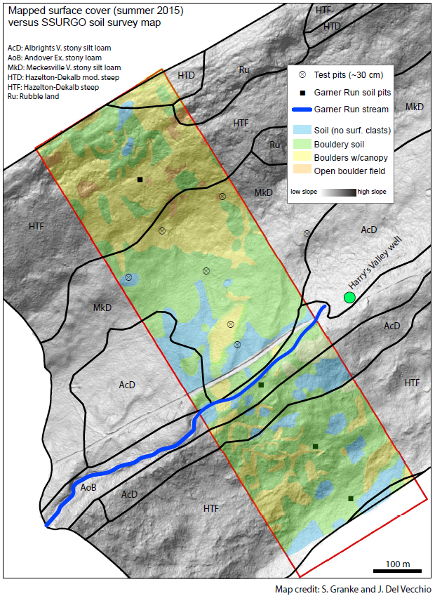
H1: Garner Run Geomorphology (DiBiase, Del Vecchio)
Summer 2015: Geomorphic/soil mapping in Garner Run
Mapped spatial distribution of surface cover in 300 m x 1000 m swath
Measured grain size distribution of surface clasts
Dug shallow soil pits to estimate clay content in soils
Sarah Granke (REU), with support from Joanmarie Del Vecchio (MS)
Aug/Sep 2015: Stream morphology surveys in Garner Run
Measured grain size distribution and shape of channel bed material
Surveyed changes in channel geometry and bedrock exposure across knickpoint on Garner Run
Caught up on prior fluvial geomorphology work done in Shavers Creek (seminal papers by Brush, Wolman, 1950s + 1960s)
Joanmarie Del Vecchio (MS)
Next steps (disciplinary):
Finish collecting preliminary survey data along Garner Run this fall
Use field data to constrain river long-profile evolution models – can we untangle lithology vs. baselevel controls on Garner Run knickpoint?
Dig into/survey solifluction lobes – are there compositional differences?
Test (or build?) models of periglacial hillslope transport – can we measure/explain differences in transport efficiency between Shale Hills and Garner Run?
Next steps (requiring collaboration):
Garner Run drilling shows at least 10 m of colluvium in valley floor. Can we date this material??? Could be key constraint on rate of periglacial hillslope modification
Along these lines... does it make sense to conduct geophysical surveys of valley floor? Shallow seismic?

Slide 53
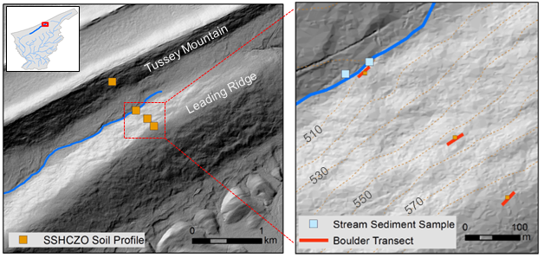
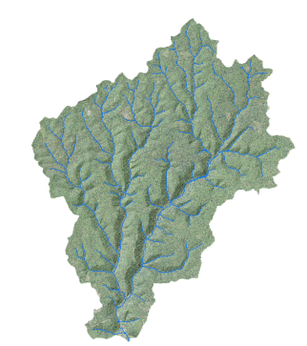
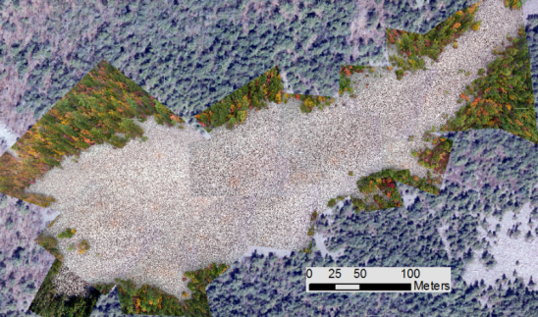
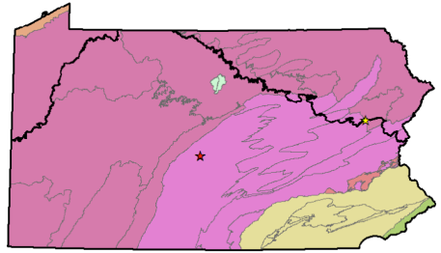
H1: Detecting landscape response to perturbations by climate and base level in central Pennsylvania using in-situ ¹⁰Be and ²⁶Al
Alison Denn, Advisor: Paul Bierman, M.S. in Geology, University of Vermont
We analyze cosmogenic ¹⁰Be in soils, amalgamated boulder transects, and stream sediments at Garner Run in order to measure rates of regolith generation and transport in this quartzite-underlain catchment.
We then examine two end-member sites that illustrate the influence of climate and base level on the development of the critical zone in Pennsylvania.
BASE LEVEL
CLIMATE
Young Womans Creek Watershed
Hickory Run Boulder Field
How does regolith behave in a transient landscape that is adjusting to changes in base level?
How have glacial/interglacial cycles impacted the generation of regolith from bedrock?

Slide 54
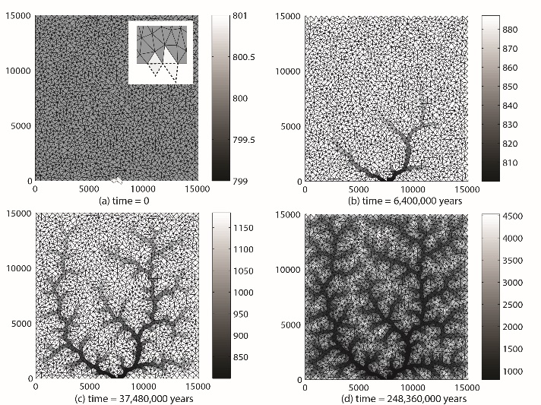
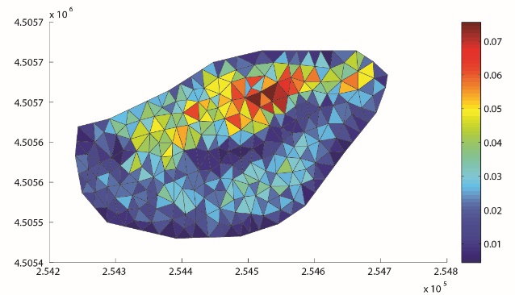
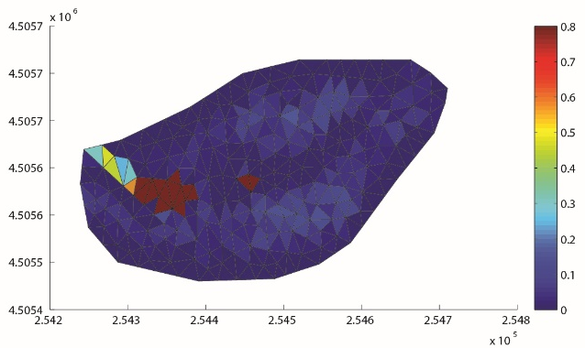
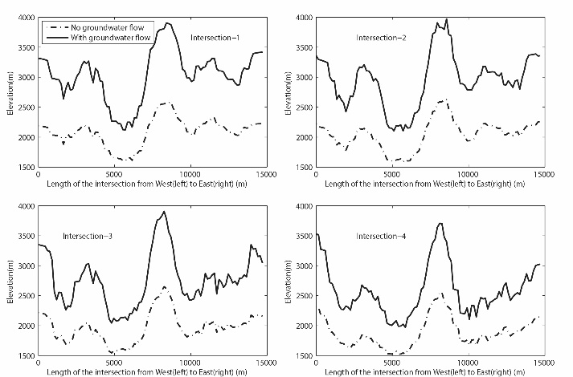
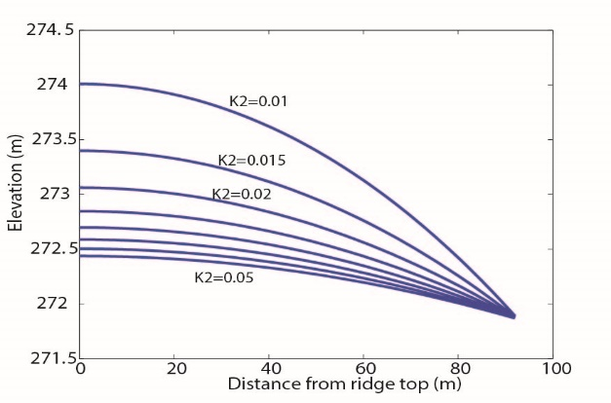
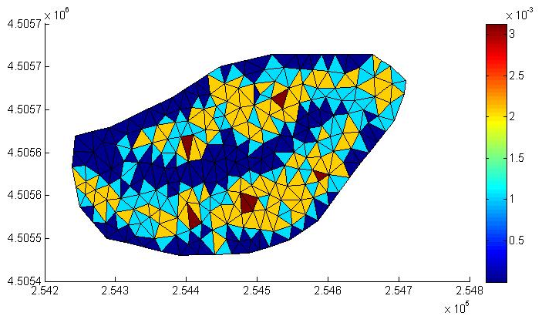
H1: A New Hydrologic-Morphodynamic Model for Regolith transport and Landscape Evolution
Yu Zhang, and Rudy Slingerland
I. Synthetic experiment
II. Application in SSHCZO
The diffusion flux is higher at the South-facing slope and lower at the North-facing slope. Flux is higher at upstream and lower at downstream.
No Advection flux at the ridge top. The flux rate is very small at middle and upstream. The fluxes on both side of hillslope is similar. The largest flux happens near the swales.
Precipitation partially infiltrates into the regolith forming smaller overland flow and lower sediment erosion rate, thereby creating a higher relief at steady-state and steeper valley walls (Solid line: with groundwater; Dash line: Without groundwater).
Left: The analytic solution of 1-D landscape at Steady state indicates that the hillslope is not sensitive to the change of tree-throw coefficient.
Right: Tree-throw flux rates are similar at the hillslopes and are in the same magnitude as diffusive flux. Therefore, it is important to consider tree-throw flux in calculating the total sediment transport.

Slide 55
H2: Kaye Lab Updates - Lillian Hill
Ground HOG:
  Garner Run – all equipment deployed (except for possibly lysimeters on LRRT)
    Data looks well and is following patterns (i.e. increases in CO₂ as you move deeper into soil profile, decreases in O₂ as you move deeper into soil profile)
      Decision to be made about water collected from lysimeters (what to measure for)
  Shale Hills – TDRs, Gas Access Tubes and sensors deployed (working on quality checks)
    Working on programs for dataloggers
    Maintenance on Lysimeters

Slide 56
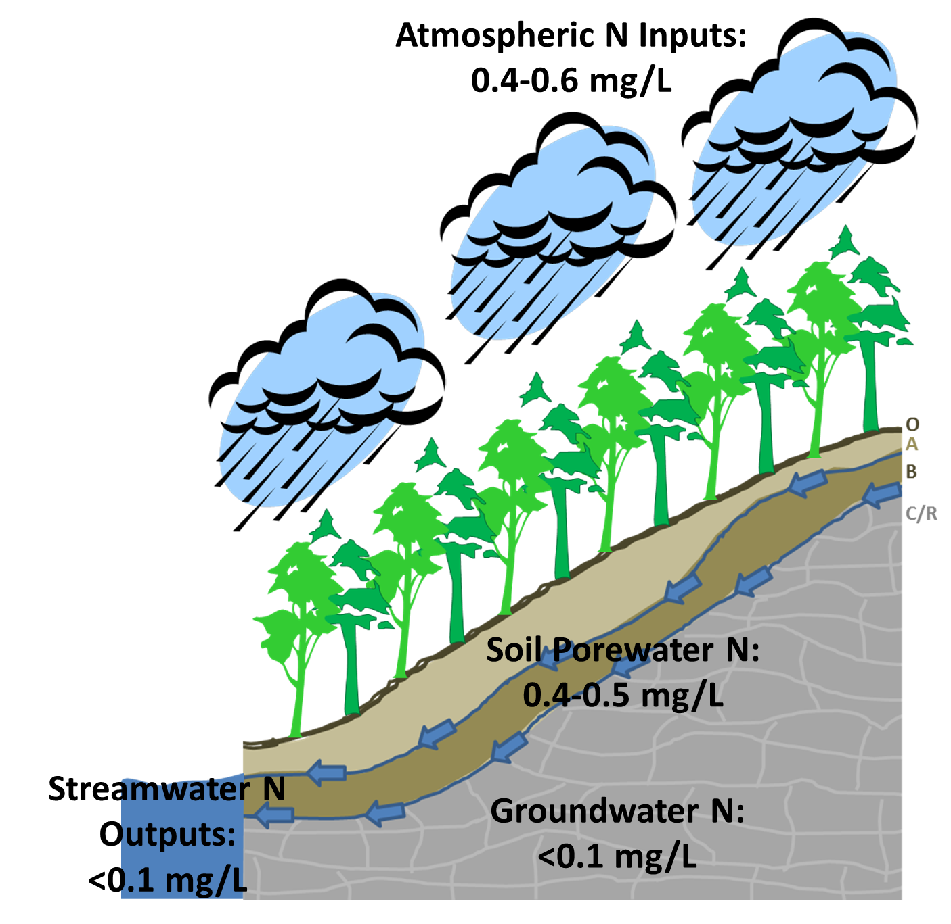
H2: Biogeochemistry Kaye Lab
Julie Weitzman – PhD Candidate
Mass Balance of N at Shale Hills
Inorganic N inputs > outputs
~0.4 kg N/ha/yr retained in the fall
vs.
~1.1 kg N/ha/yr retained in the spring
This suggests demand for available N
is high, and that Shale Hills is not yet
N-saturated, but, rather, is still N-limited
Hypotheses currently being tested:
N is being retained in O-horizon soils
N is being quickly taken up in vegetation
N is leaving the system via DON

Slide 57
H3: CZO Project- Eissenstat group
How does lithology affect or is affected by root traits and associated mycorrhizal fungi?
How consistent are traits of a tree species among different sandstone sites or among different shale sites?
Are root and mycorrhizal fungal function similar for shallow and deep roots?

Slide 58
H3: People
Summer- REU student and RET trainee, Liza also helped
Mapped roots at Garner run and sandstone and shale sites at Tuscarora forest
Hope to identify roots and mycorrhizas as examine how deep roots differ from surface roots (led by Ismaiel Szink)

Slide 59
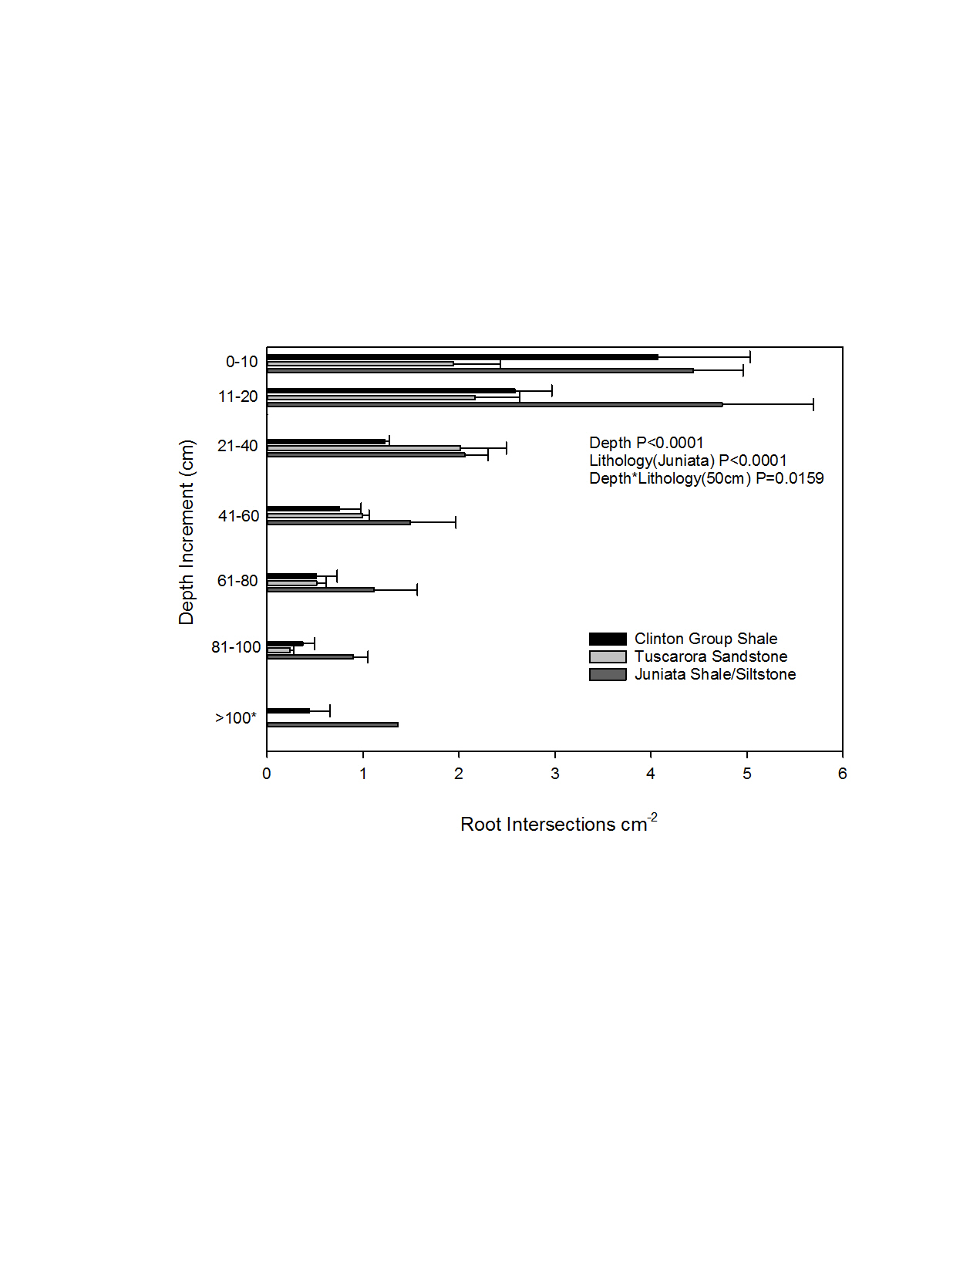
H3: Tuscarora Summer Results
Root density with depth

Slide 60
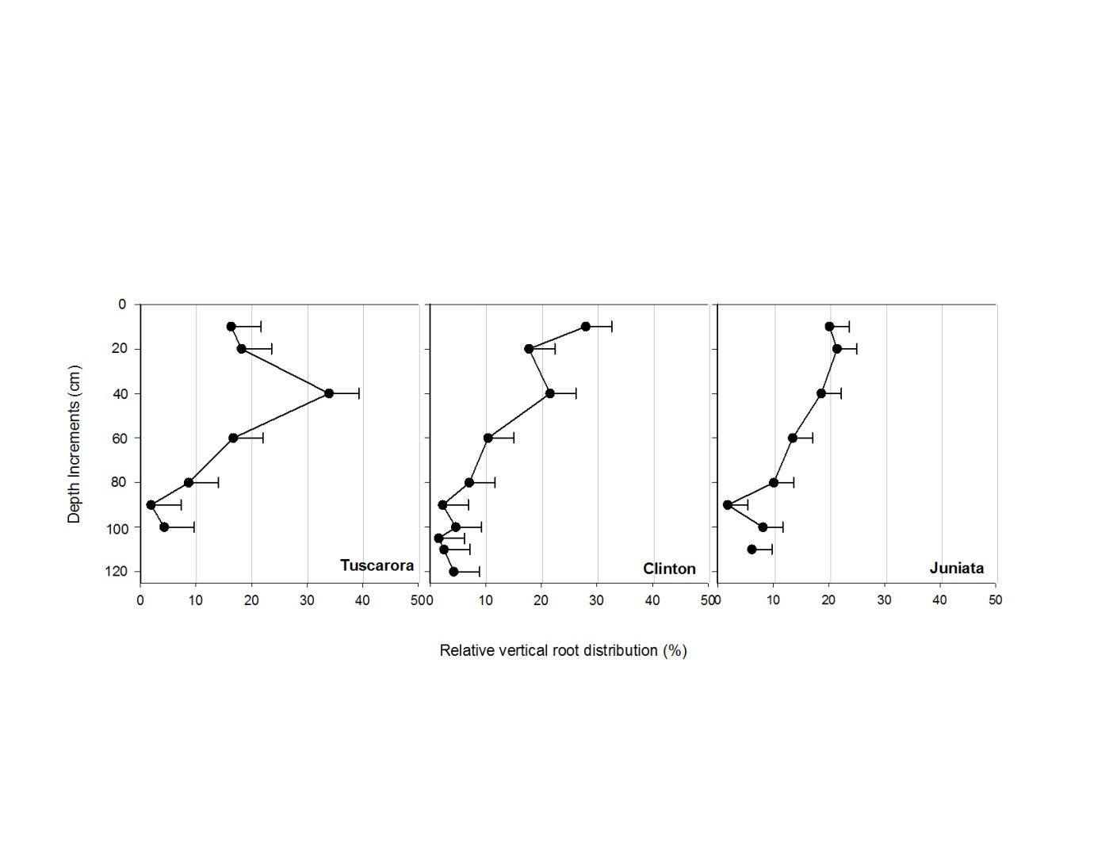
H3: Results cont.
Relative root distribution

Slide 61
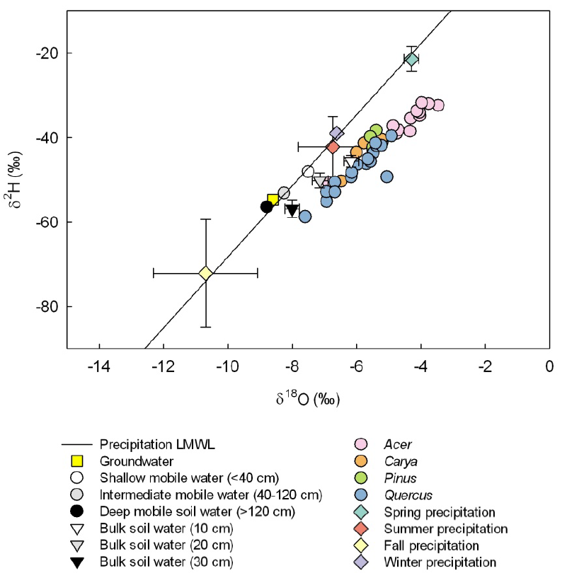
Gaines, K. P., et al., 2015. Reliance on Shallow Soil Water in a Mixed-Hardwood Forest in Central Pennsylvania. Tree Physiology. Submitted.
H3: Tree xylem water and potential source water D2H and D18O compositions with an amount-weighted local meteoric water line (LMWL), including average groundwater, average mobile soil water, average bulk soil water by depth, and amount-weighted seasonal precipitation. Error bars represent mean standard error. Equation of weighted LMWL: y=8.4x +15.8.

Slide 62
H3: Vegetation Survey results
Catena | Area sampled (m2) | Tree basal area (m2/ha) | Tree density (stems/ha) | Tree species richness (# spp./ha) | Dominant tree species (% basal area; trees >10 cm diameter at 1.57m height on trunk) | % “exposed” rock
LRRT | 1000 | 25.3 | 607 | 9 | Quercus prinus (44%), Acer rubrum (19%), Pinus strobus (19%), Nyssa sylvatica (12%) | 16
LRMS | 1400 | 25.1 | 610 | 9 | Betula lenta (37%), Quercus prinus (21%), Nyssa sylvatica (15%), Quercus rubra (10%) | 28
LRFS | 700 | 24.6 | 371 | 20 | Quercus rubra (26%), Betula lenta (23%), Quercus prinus (200%), Acer rubrum (14%) | 36
TMMS | 1000 | 18.5 | 519 | 9 | Acer rubrum (32%), Betula lenta (29%), Nyssa sylvatica (25%) | 34

Slide 63
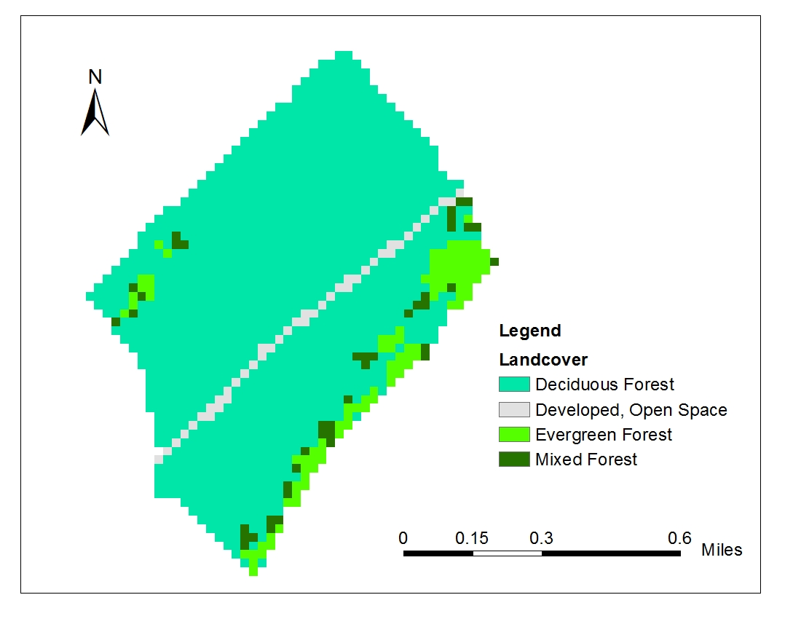
H3: Land Cover
Road
Type | Proportion
Deciduous Forest | 87.33%
Developed, Open Space | 2.88%
Evergreen Forest | 6.90%
Mixed Forest | 2.88%

Slide 64
H4

Slide 65
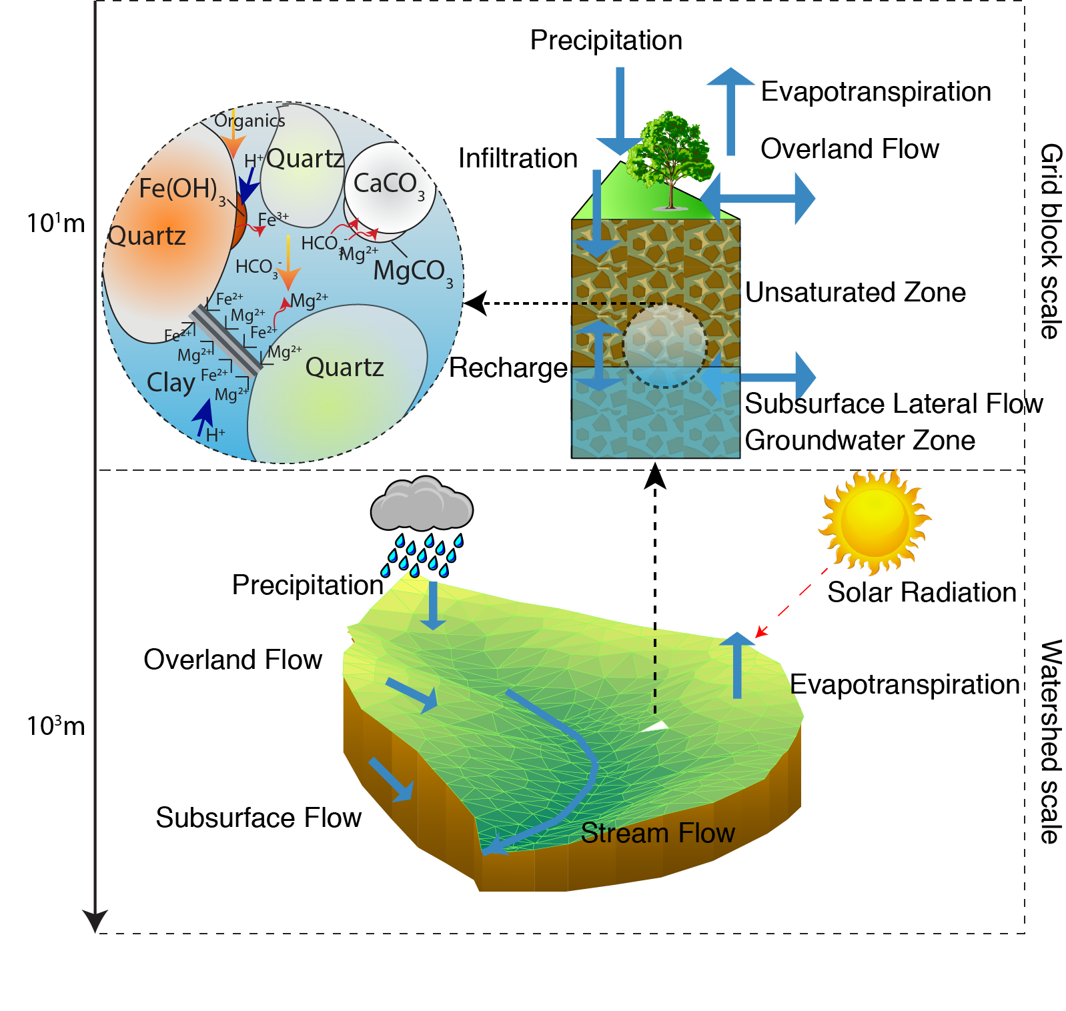
H5: Developing RT-Flux-PIHM: A Coupled Hydrological, Land Surface, and Reactive Transport Model
Hydrologic, Land Surface Model
Reactive Transport Model
Programmed in C, 10K lines of code, Operator splitting method, Gupta type TVD, Adaptive/ Local time stepping
Bao et al., submitted to WRR

Slide 66
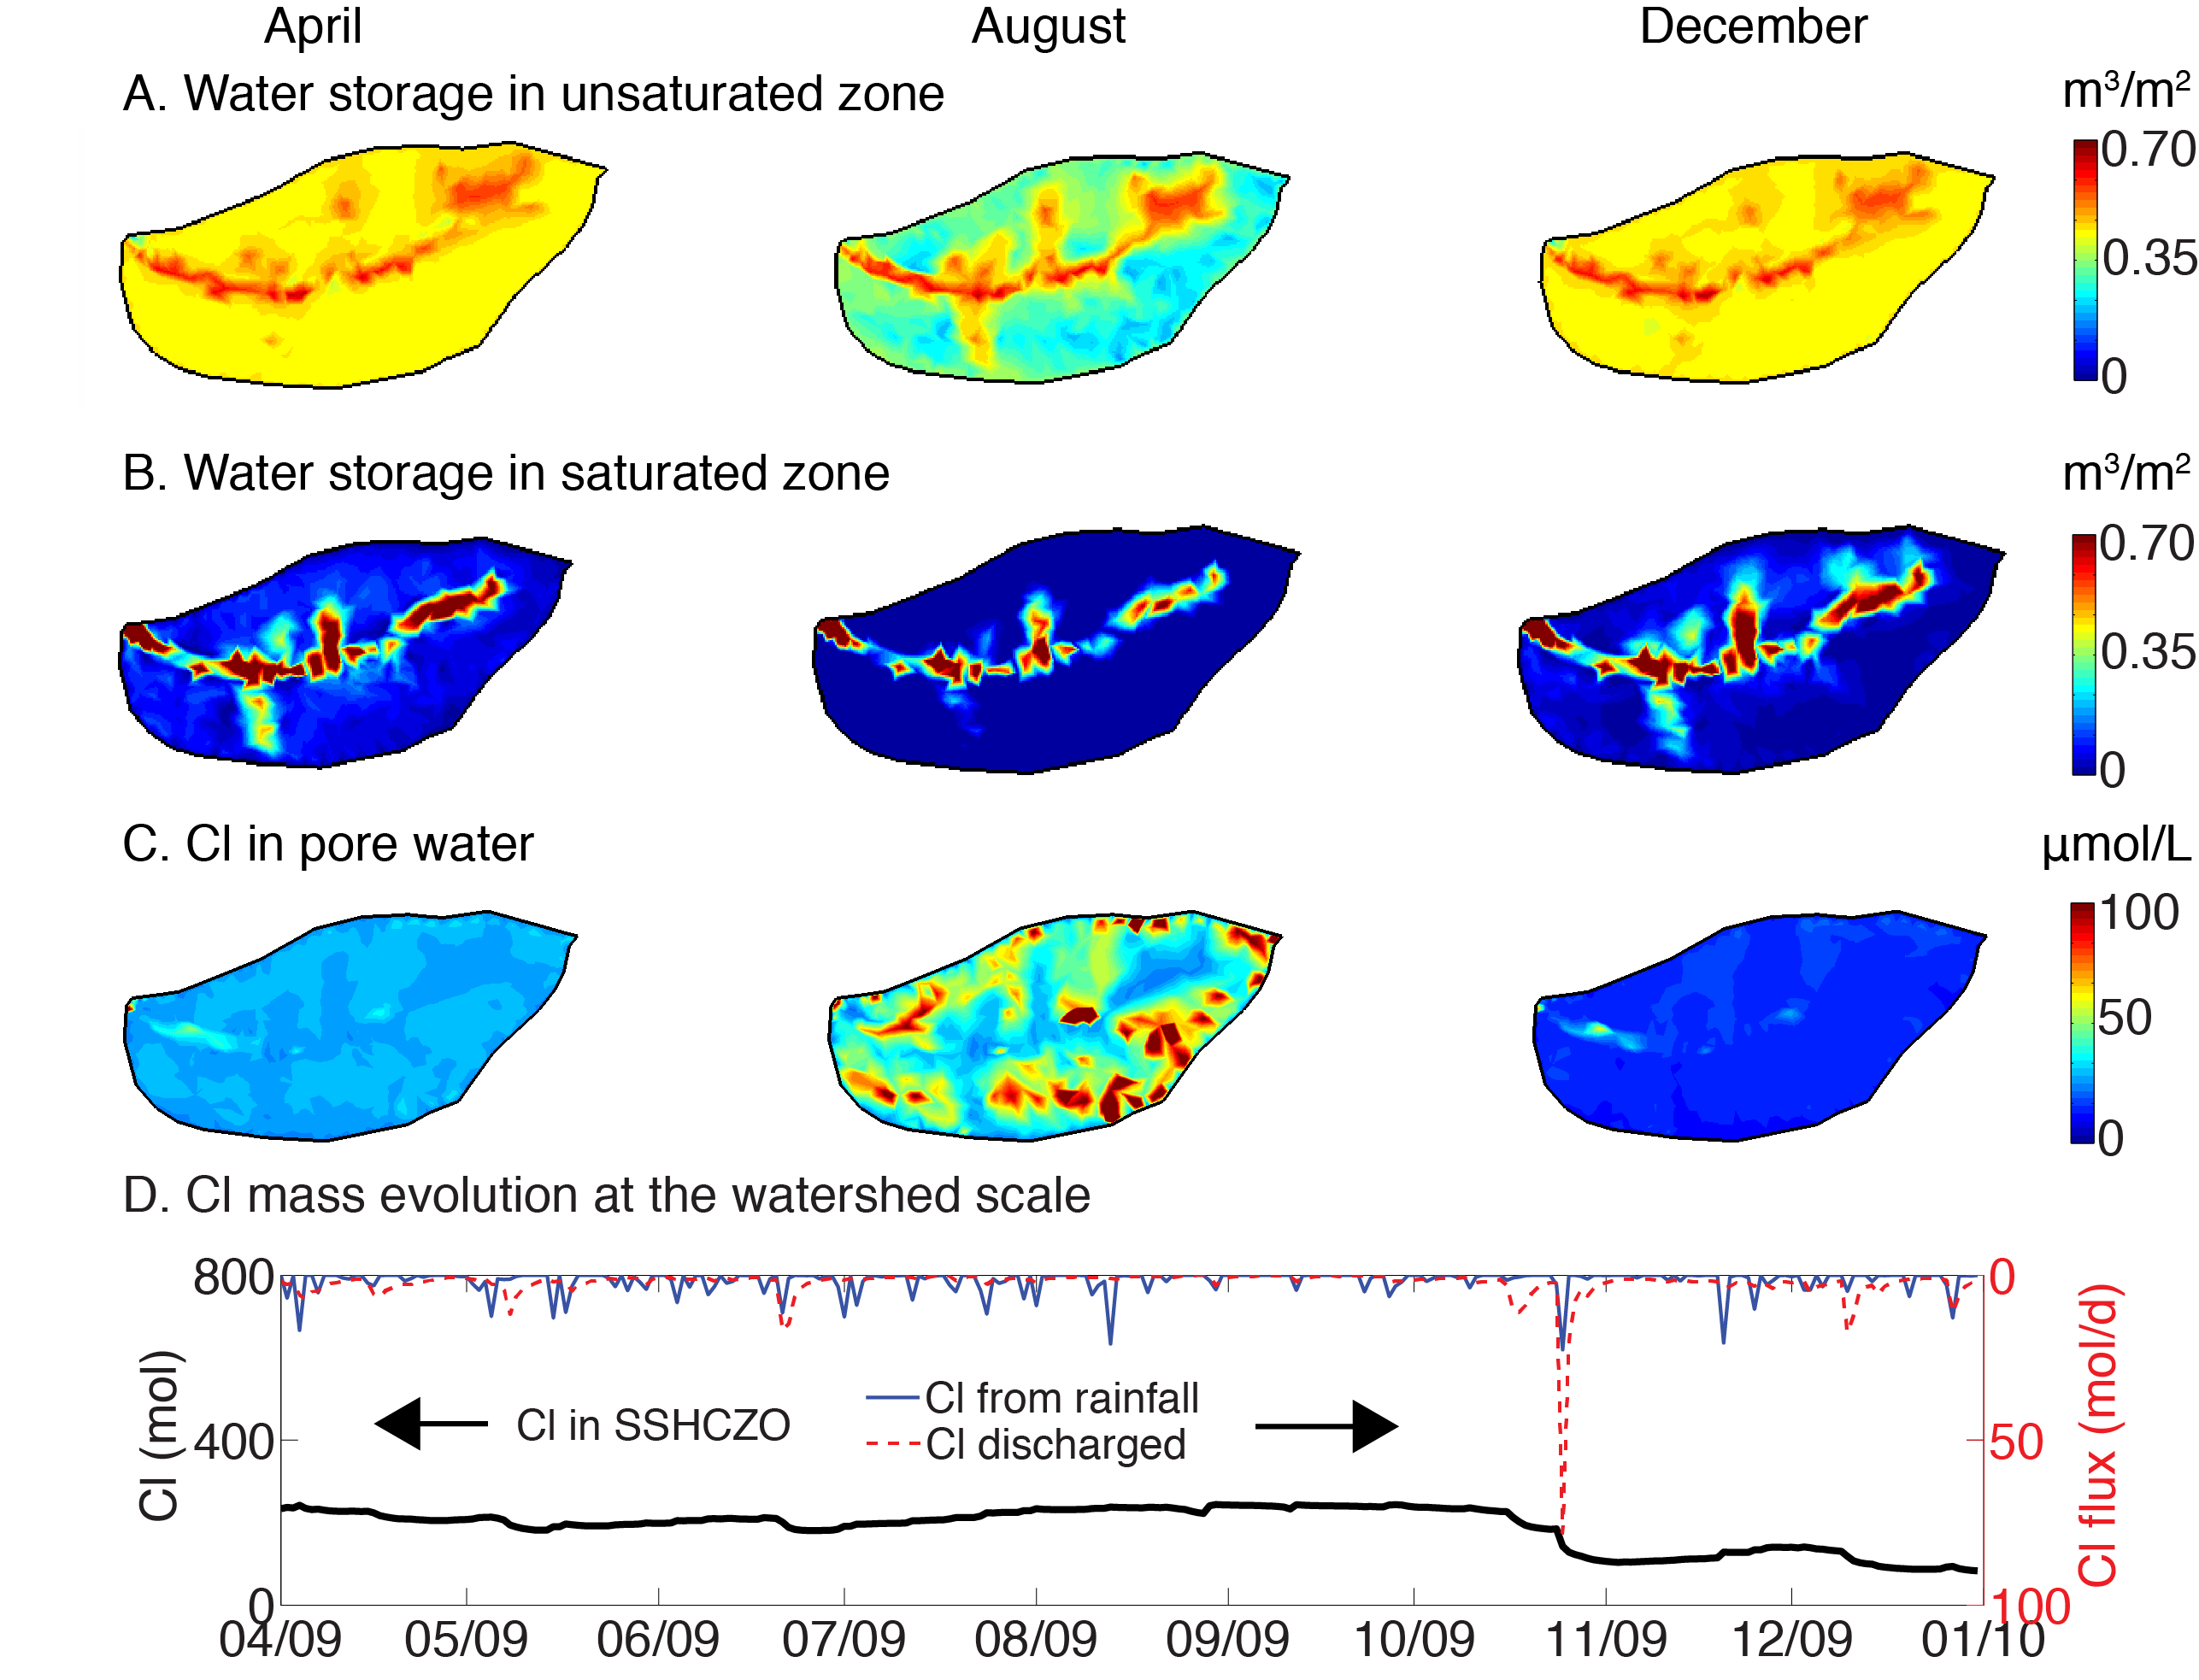
H5: Understanding Hydrogeochemical Coupling at the Watershed Scale

Slide 67
H6
Chemistry @ all sites
Temperature | F
pH | Cl
DO | SO4
SPC | NO3
TDS | Al
ORP | Ca
Alkalinity | Fe
DOC | K
 | Mg
 | Mn
 | Na
 | Si
 | Sr
 | Ba
 | P
 | Zn
 | S
Site | Discharge and other measurements
Shale Hills | -New flume (+ existing stilling well?) -Stream seepage: 5 locations along reach (modeled to give daily values)
Garner Run | -Stilling well + flume -Have various chemistry at multiple locations along reach including spring -New groundwater well: started chemistry meas. need to purchase smaller water level loggers -Planning to do another ct. injection tracer test -S::CAN Sensors
SCAL | -Stilling well + flow tracker meas.
SCBL | -Stilling well + flow tracker meas.
SCO | -Stilling well + flow tracker + ADCP (borrowed) + S::CAN in-situ spectrometer
Chemistry measurements taken 1-2 times per month

Slide 68
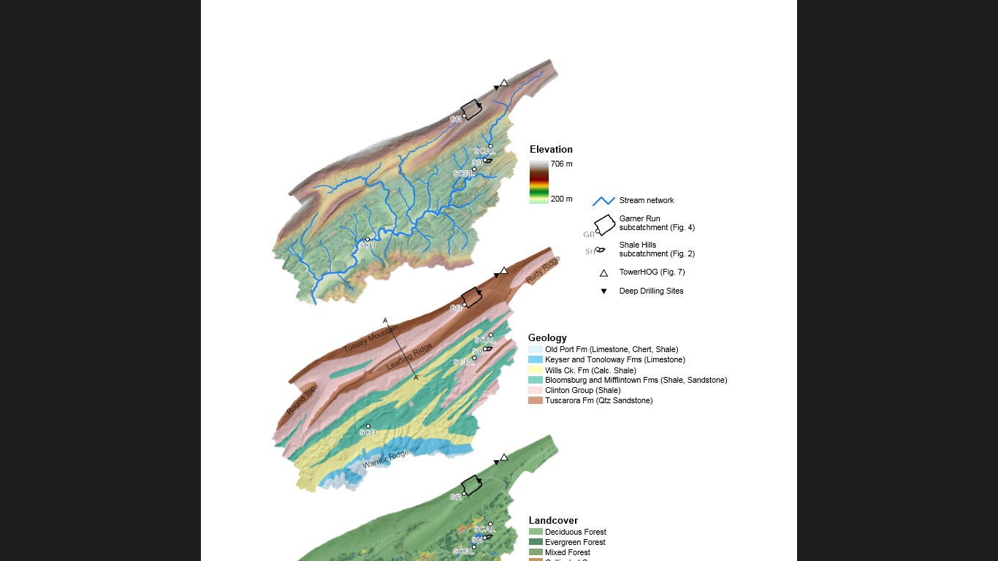
H6: Progress Update (C-Q Relations)
GRO
SCAL
1. Weekly to bi-weekly water sampling and Q measurement at Shaver’s Creek sites
2. Rating Curves developed for each site
3. Preliminary C-Q data for watershed suggests dilution in Ca (similar to SH) AND Mg (dissimilar to SH)
4. DTS data and stream sampling at GR suggest significant hyporheic exchange and localized GW input (i.e. spring)
5. Groundwater well installed at GR
6. Techniques in Environmental Geochemistry class exploring CEC at GR, longitudinal changes in stream solute chemistry, and S::CAN sensor data
SH
SCBL
SCO

Slide 69
Watershed Average
H7
5 6 7 8 9 10 11 12 1 2 3 4 5 6 7
2009
2010
Spatial variation
wet site
dry site
wet site
dry site

Slide 70
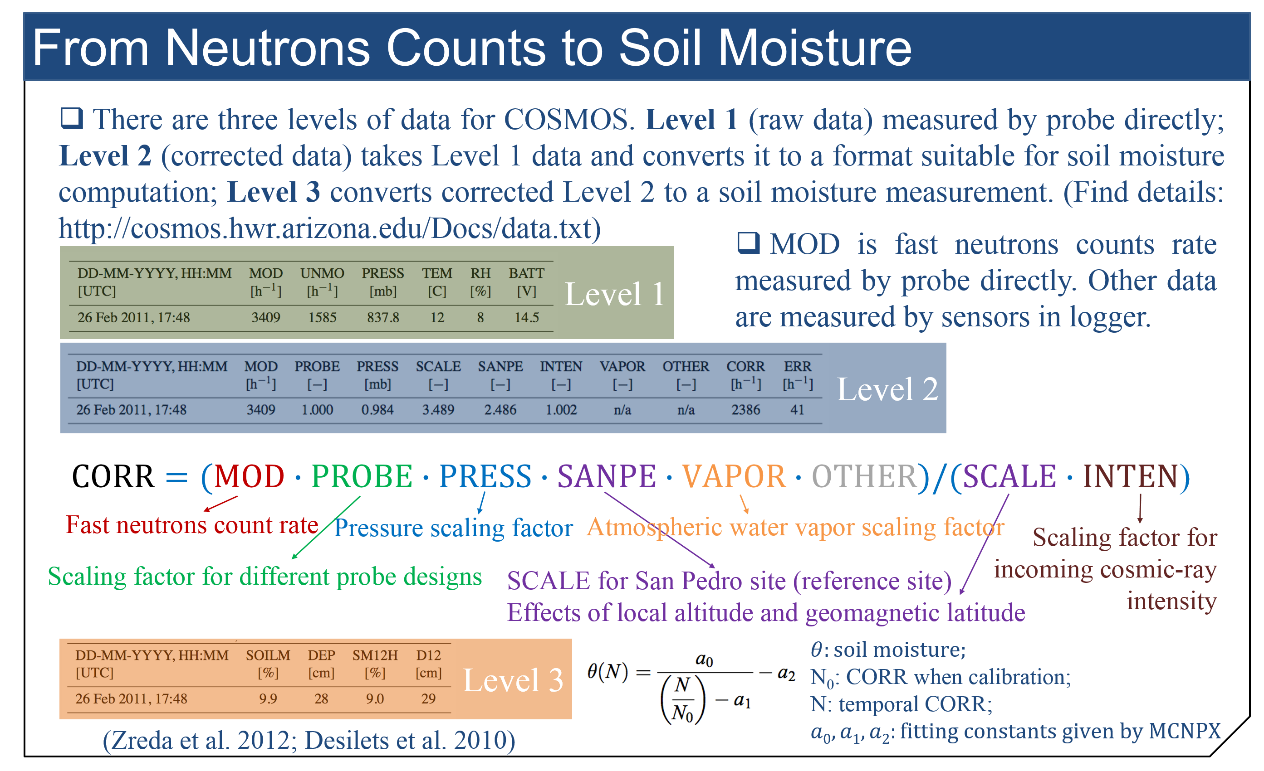
H8. COSMOS Correction and Calibration in GR

Slide 71
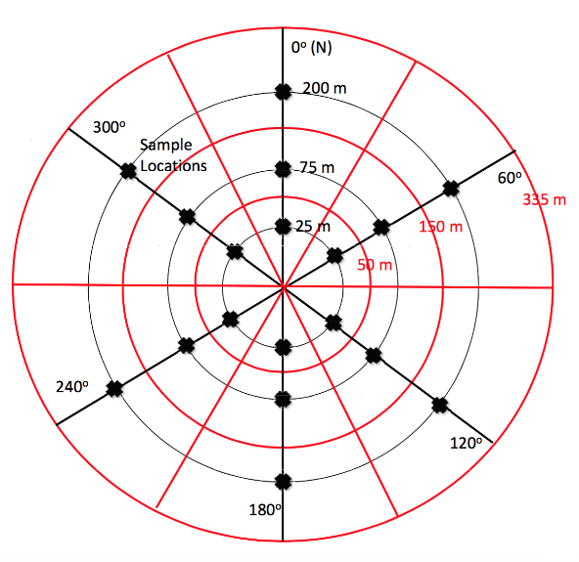
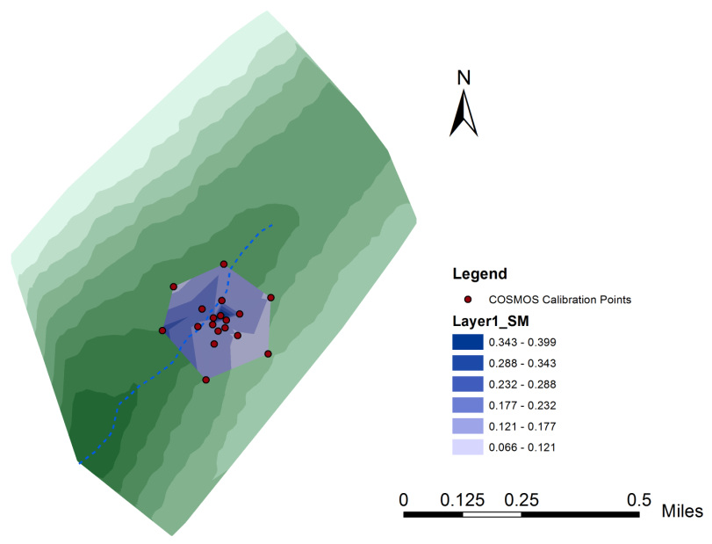
H8. COSMOS Correction and Calibration in GR
For instrument calibration, 108 soil samples will be collected at 18 different locations using a split corer and measured by oven-drying method.
Three radial distances from the probe station: 25 m, 75 m, and 175m, ± a few meters;
Six radial directions, every 60 degree starting from an arbitrary azimuth;
30 cm depth soil samples for each location.

Slide 72
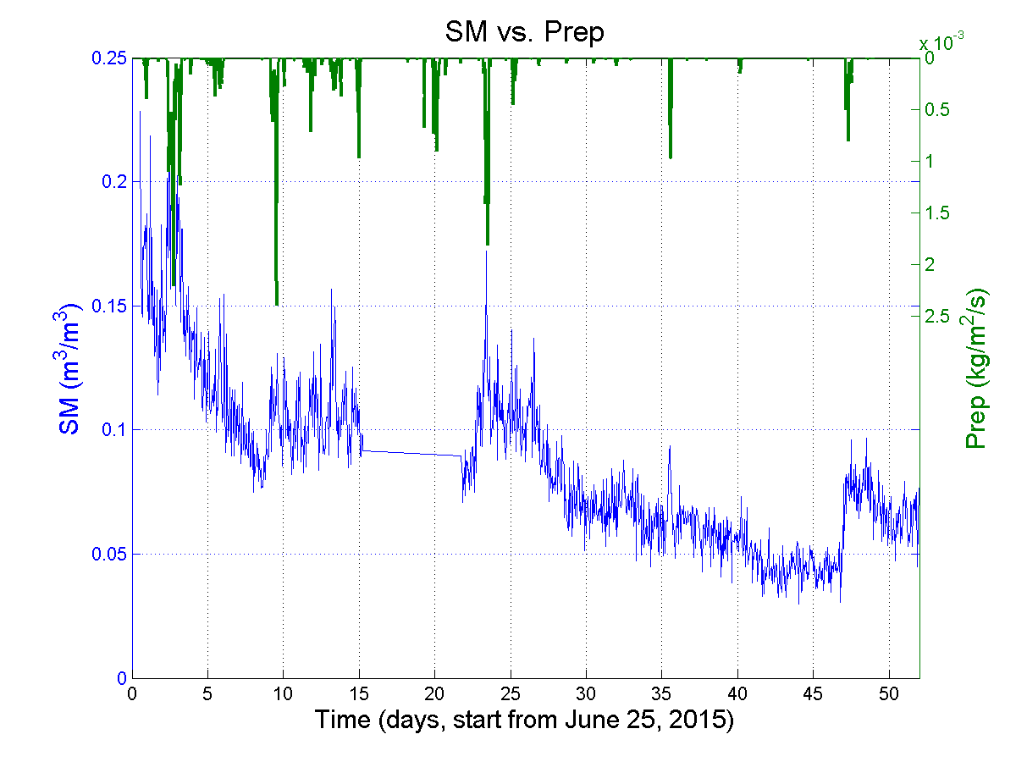


H8. Corrected SM(VWC) Results

Slide 73
H9: Developing approaches to Earthcast climate controls on solute fluxes during shale weathering
Paper presented on this at 2015 Goldschmidt, paper in prep for publication by Pam Sullivan, Yves Godderis, Sue Brantley, possibly others

Slide 74
DATA NEEDS FOR WATER

Slide 75

Are we measuring the data needed for FluxPIHM?
CR: Discharge, WTD, SWC, LST, sensible and latent heat fluxes, transpiration
NoSWC: Discharge, WTD, SWC, LST, sensible and latent heat fluxes, transpiration
Θ_{e}: soil porosity; α and β: van Genuchten soil parameters; R_{cmin}: minimum stomatal resistance; S: canopy water capacity; C_{zil}: Zilitankevich parameter (affects surface turbulence)

Slide 76

Soil Type (SSURGO)
MUKEY | MUSYM | Soiltype | Proportion
538281 | HSD | Hazleton extremely stony sandy loam, moderately steep | 0.45%
538282 | HTF | Hazleton-Dekalb association, very steep | 0.45%
541950 | AcD | Albrights very stony silt loam, 8 to 25 percent percent slopes | 18.75%
541952 | AoB | Andover extremely stony loam, 0 to 8 percent slopes | 5.80%
541973 | BxD | Buchanan extremely stony loam, 8 to 25 percent slopes | 0.89%
541993 | HTD | Hazleton-Dekalb association, moderately steep | 2.68%
541994 | HTF | Hazleton-Dekalb association, steep | 48.21%
542002 | HsB | Hazleton-Dekalb extremely stony sandy loams, 0 to 8 percent slopes | 1.34%
542019 | MkD | Meckesville very stony silt loam, 8 to 25 percent slopes | 19.20%
542039 | Ru | Rubble land | 2.23%

Slide 77

Are we moving toward a soil map that will be available for FluxPIHM?

Slide 78
“Minimum” measurements
Conclusions based on data assimilation experiments at Shale Hills
Category | Variable | Note
Forcing data | Precipitation Air temperature, humidity, wind speed, surface pressure Solar and thermal radiation Leaf area Index | Reanalysis and remote sensing products are available with acceptable accuracy
Static input data | Surface topography Soil distribution and hydraulic properties Land cover map | National soil database cannot meet the requirement of high resolution modeling. National surface elevation and land cover databases are sufficient.
Calibration data | Outlet discharge Point measurements of soil water content Watershed average (or point?) Land surface temperature (or sensible and latent heat fluxes) | Locations of SWC point measurements might be important, and need to be tested. Point measurements of LST have not been tested, but might work, too.
Parameters! | Porosity Van Genuchten parameters (α, β) Stomatal resistance Canopy storage Zilitankevich parameter | Van Genuchten and porosity derived from field measurements. Stomatal resistance from leaf experiments. Canopy storage from throughfall. Z is modeled.

Slide 79
DATA NEEDS FOR CHEMISTRY

Slide 80
Data for RT-FLUX-PIHM, the water chemistry model (months to years)?
Water – Yuning already talked
Groundwater flow and surface-ground water interactions?
Spatial heterogeneities
Properties of different soil horizons (depth, porosity, permeability, soil carbon)
Tracer test for the heterogeneity quantification
Chemistry
Water chemistry (pH, Ca, Mg, K, NO3-, Cl-, DOC, …)
Stream (month) and pore water chemistry (different horizons)
Groundwater chemistry
Solid chemistry (mineralogy)
Soil gas (CO2 and O2)
Time evolution data are important

Slide 81
Regolith-PIHM-RT model (10³-10⁵ yrs)
In between LE-PIHM and RT-PIHM-RT
Initial condition (e.g., topography and mineralogy)?
Perturbation: Meteorological forcing over time
- average precipitation
- rain water composition
- Detailed time evolution is less important, temporal averages are more important
Response: Vertical soil chemistry profiles (different topographic locations)
Can not ignore erosion - Data for erosion rate (sediment transport)
When did we start to have trees? What are the role of trees?

Slide 82
Measurements
Soil chemistry versus depth and position at a small number of pits
Porewater chemistry versus depth and position at a small number of pits
Soil gas chemistry versus depth and position at a small number of pits
Streamwater chemistry at ?Shale Hills?, ?Garner Run?, three sites on Shavers creek

Slide 83
How will we upscale

Slide 84
Upscaling
Geophysical measurements (GPR, EMI at Garner Run, others at Shale Hills)
LiDAR
Modelling
Stream chemistry and discharge

Slide 85
Fin

