Slide 1
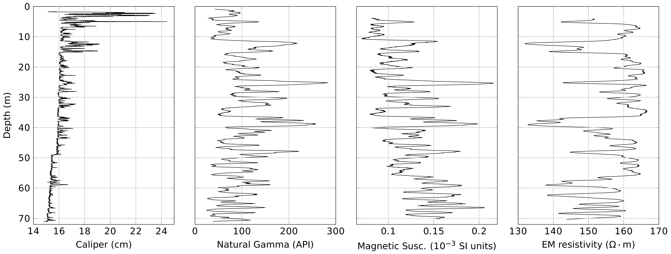
Borehole logging of Jo Hays well by Brad Carr
Quartzite/shale sequences;
quartzite: low natural Gamma, low magnetic susceptibility, high resistivity
Water table at 62.6 m

Slide 2
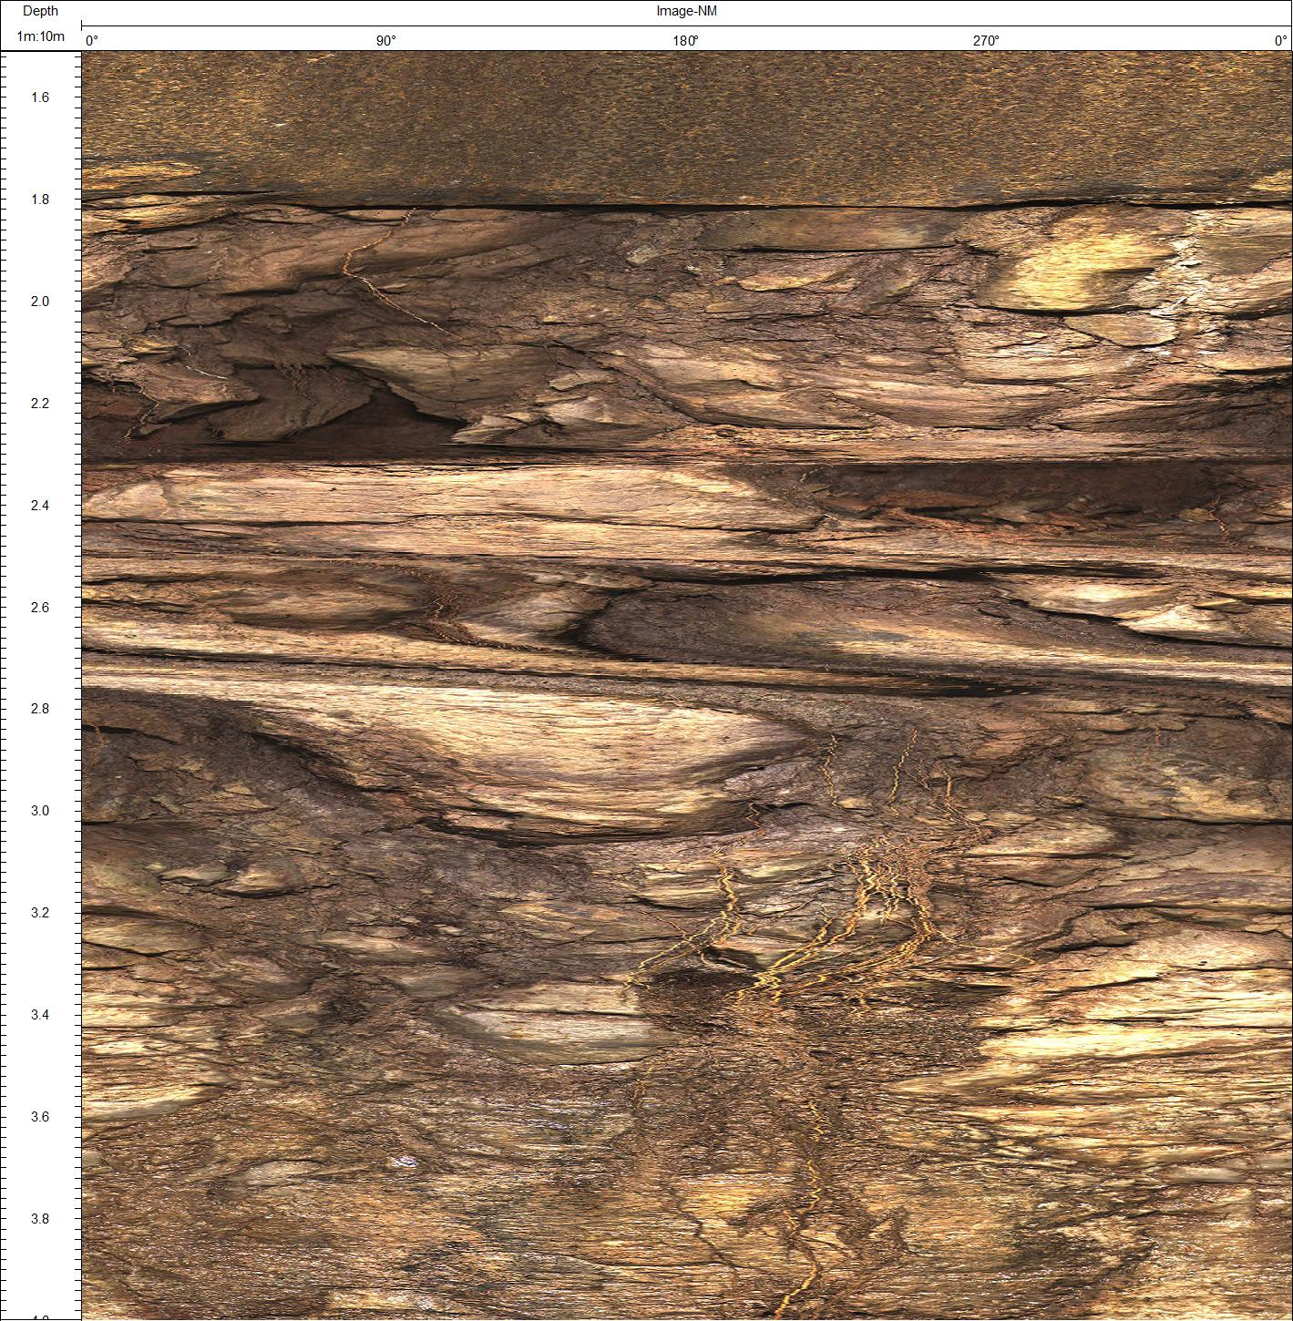
Casing
Roots

Slide 3
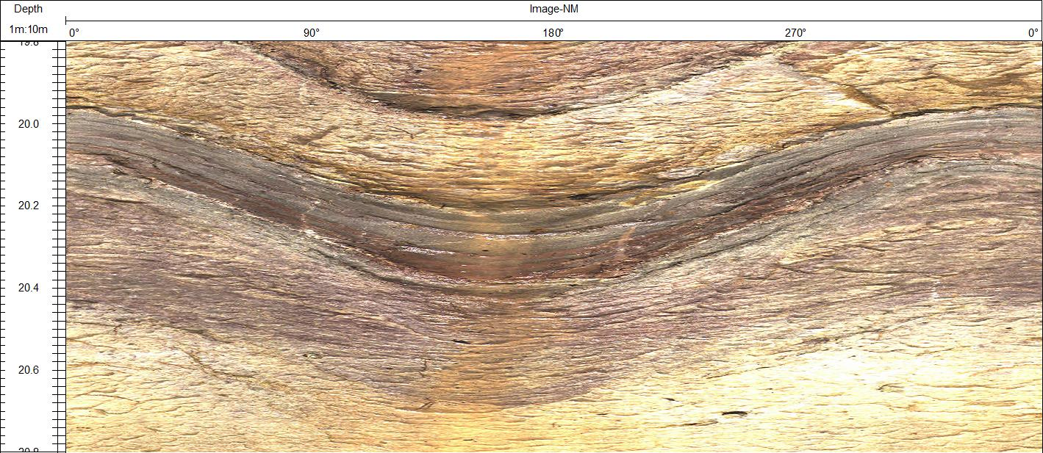
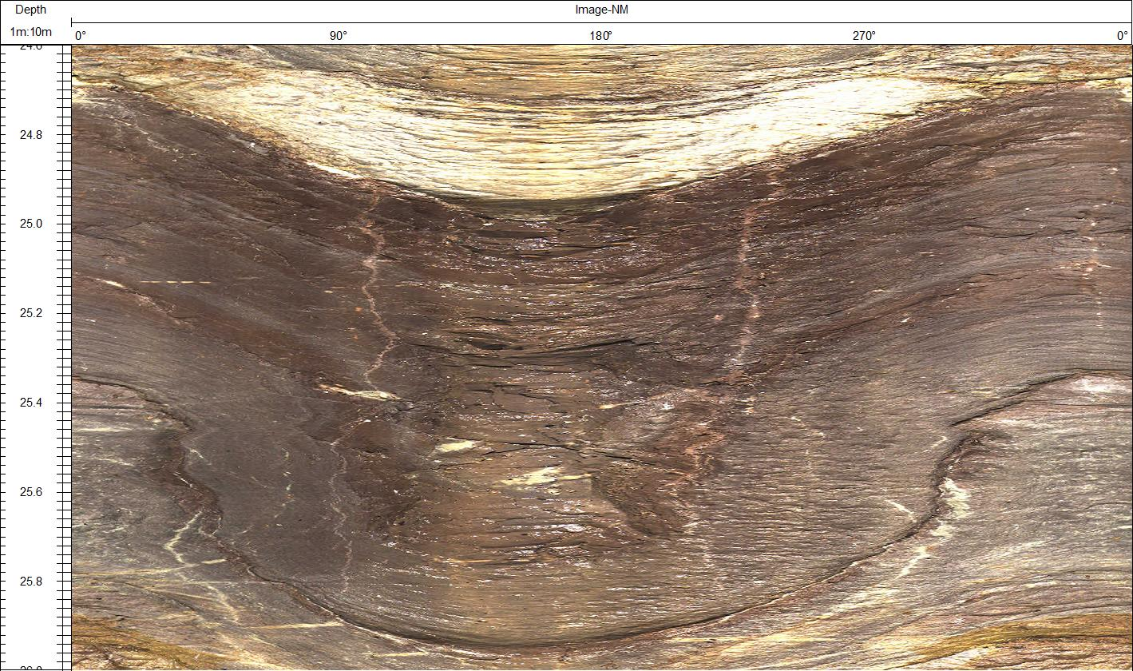
Example of thin shale bed
Example of thick shale bed

Slide 4
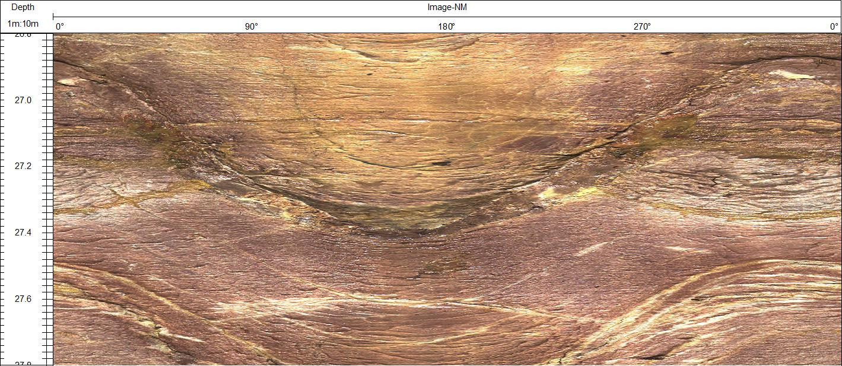
Above the water table, shaly layers look wetter than the sandy layers.
sandstone
shale

